Slide 1
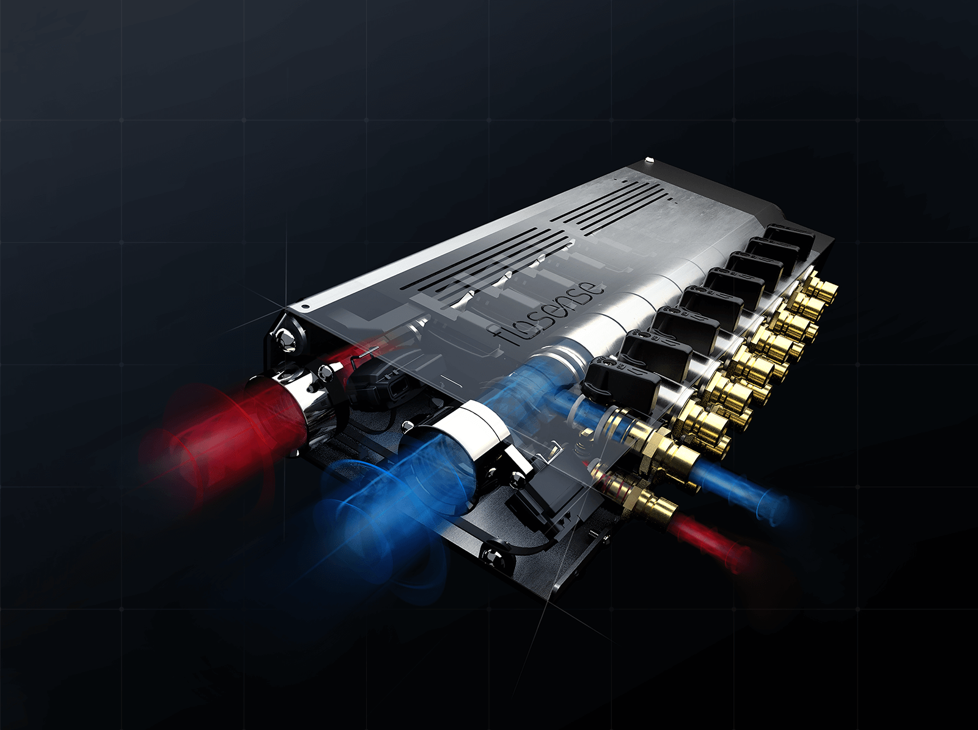
P R E Z E N T A C I J A

Slide 2
AGENDA
Zakaj je potrebno nadzirati
Pretok & Temperaturo?
Flosense produkti in aplikacije
Flosense 1.0
Flosense 2.0
Flosense 3.0
Flosense 4.0
Flosense 5.0 /pride kmalu/
DIGITAL FLOW MONITOR

Slide 3
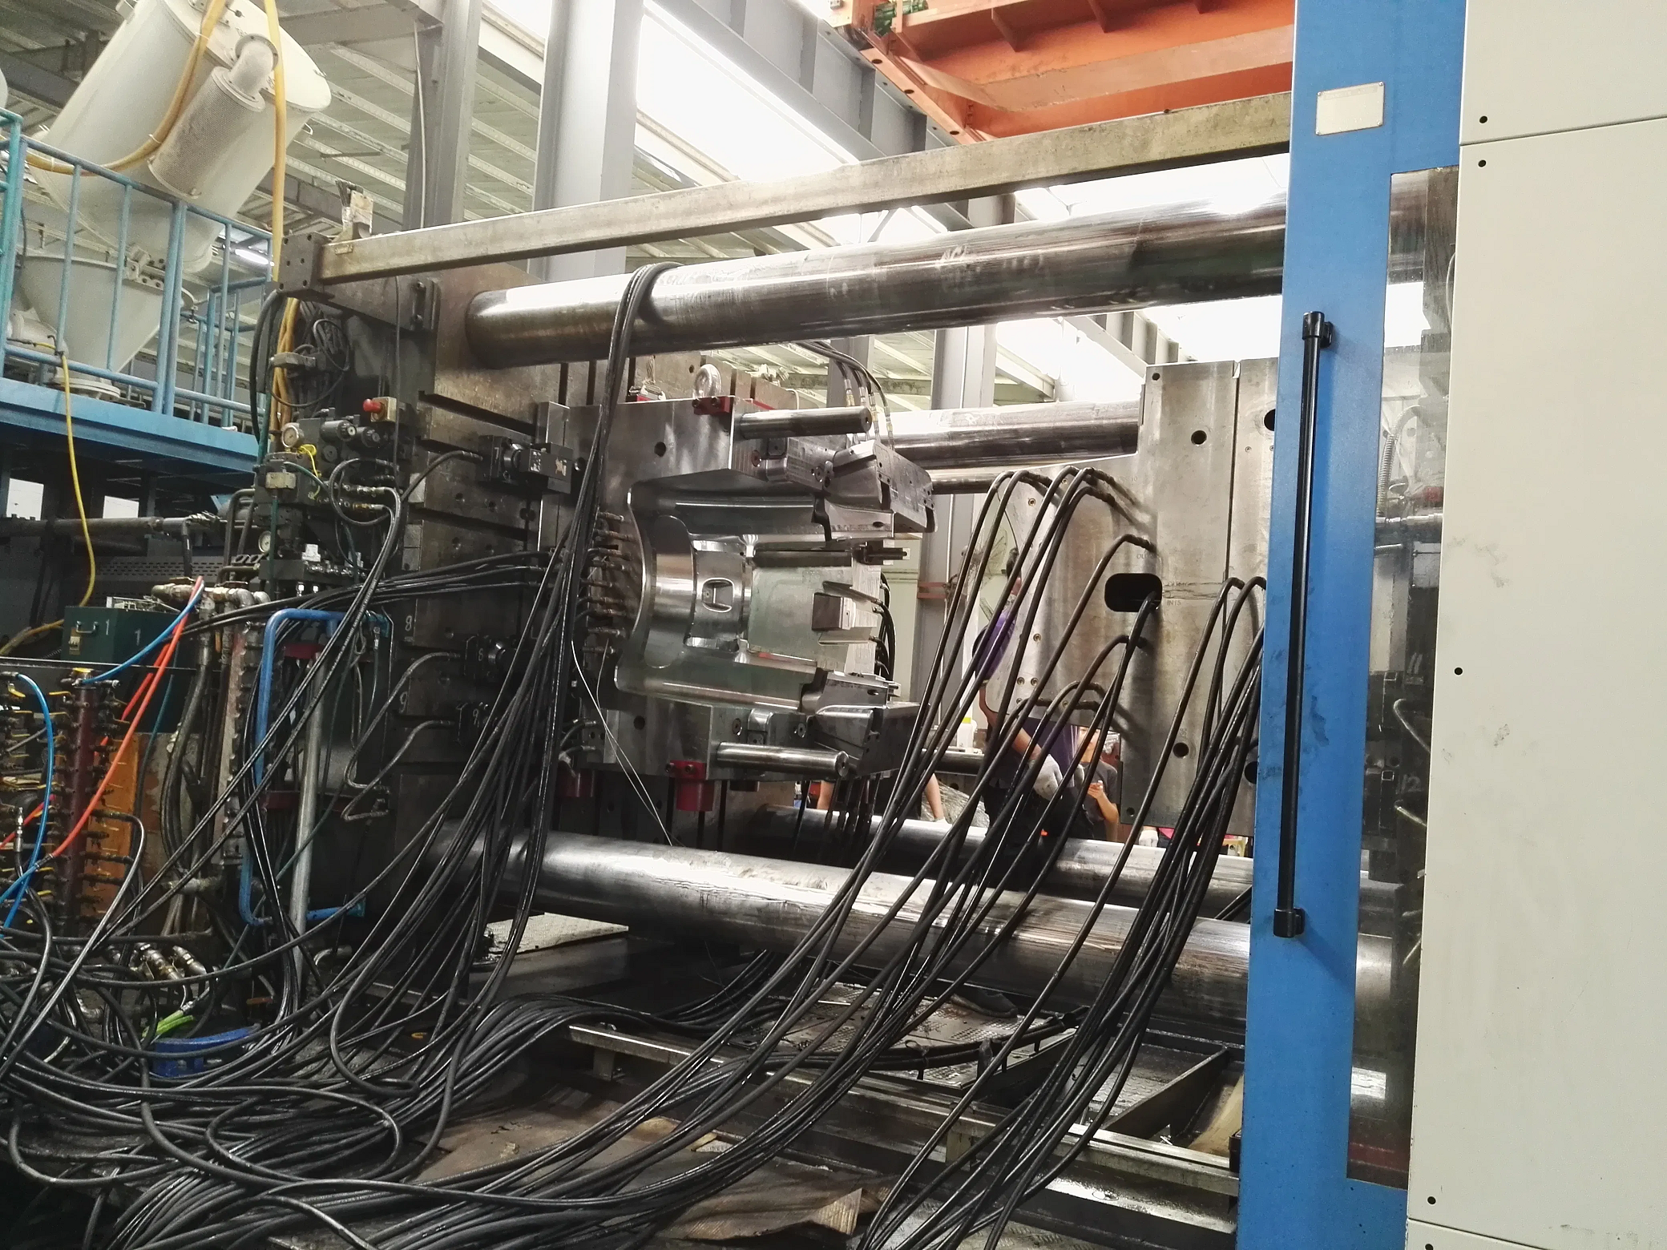
Imate organizirane svoje hladilne cevi?
Pogosta menjava brizganja?
Poznan Delta T?
Kratki časi ciklov?
Perfektna kakovost delov?
Prostor za izboljšave?
Notes:
Just because it works, it doesn’t mean it can’t be improved. We see many moulders who can benifit from organizing mould cooling lines. The investment is relatively small and the cost savings are substantial.
Emagine the set-up time to connect the mould on the picture and how do you replicate the set-up next time you run the same mould.

Slide 4

AGENDA
Pretok &
Temperatura
Flosense fokus
na prenos toplote
DIGITAL FLOW MONITOR
Notes:
Flosense stands out a little from competitors. Flow is getting a lot of attention and is essential for the process. But a more important information is that the temperature variation from inlet to outlet which is also called Delta T. Flosense focus’ on temperature and pressure variations in combination with flow, ofcourse.

Slide 5
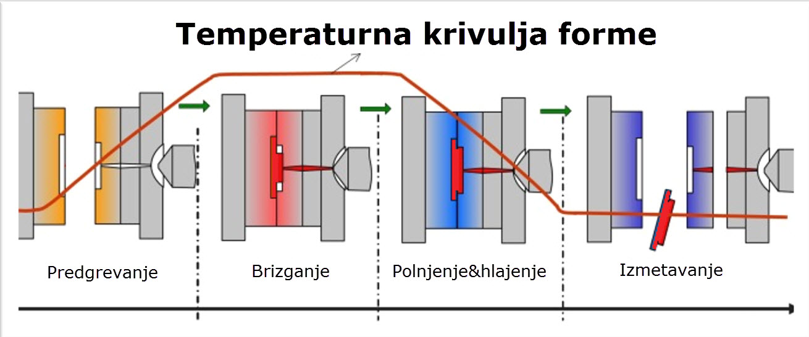
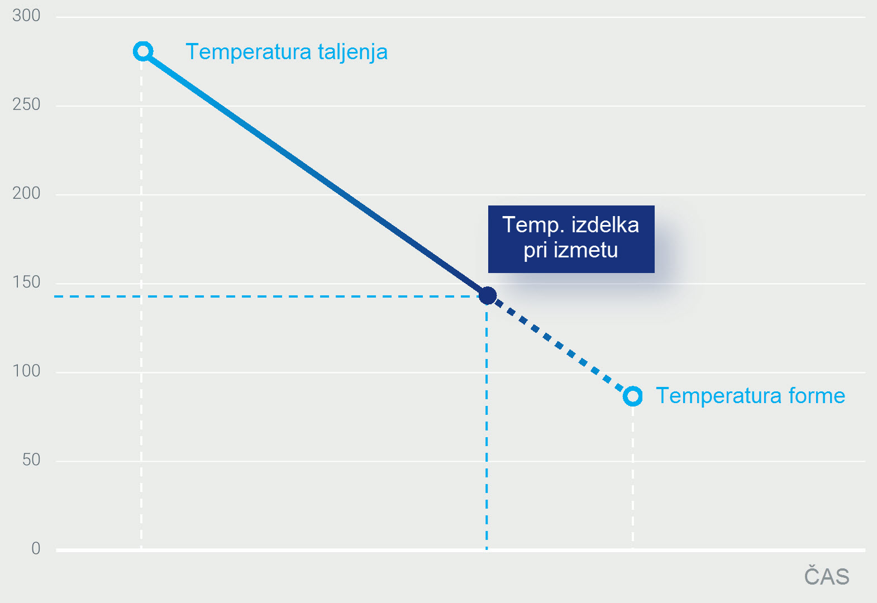
PROCESNE TAMPARATURE
FORME & MATERIALA
Taljenje / Izmetavanje
TEMPERATURA
MATERIALA
Notes:
First, just to clarify, we focus on heat-transfer and we want to control the optimal way to take out heat from the part.
The plastic processing cycle is to heat the mould, inject melted plastic, let it cool down and eject the part.
Only thing we can control is the efficiency of the cooling process to transfer the heat from the part to the cooling water so the part reaches the eject temperature. This process will define the cycle time.

Slide 6
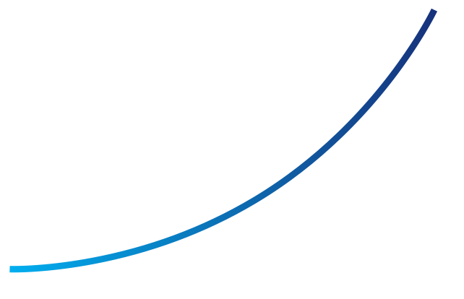
TEMPERATURNI UČINEK
NA DIMENZIJE IZDELKA
Generalno velja: z naraščanjem temperature forme narašča tudi skrček.
Višja temperatura forme daje manjši izdelek!
Zato je nujno, da natančno nadzorujemo temperaturo forme.
SKRČEK
TEMPERATURA FORME
Notes:
It matters a lot how the heat transfer is done – it is a sensitive process and we have to take many parameters into consideration.
In general terms: as mould temperature is increased, part shrinkage increases.
Higher mould temperatures give smaller parts!
Therefore, it is essential that we control the temperature of the mould accurately and consistantly, not too fast and not too slow.

Slide 7
UČINEK TEMPERATURE FORME
NA STABILNOST DIMENZIJ
VROČA
FORMA
HLADNA
FORMA
Nekateri deli imajo po brizganju slabo dimenzijsko stabilnost, saj se del še naprej stabilizira.
To lahko povzroči tudi spreminjanje dimenzij dela v skladišču.
Skrček v formi
Skrček po brizganju
Dimenzije kalupa
KONČNA DIMENZIJA
IZDELKA
Notes:
As long as the part is in the mould – we can still control the process, but once it is out, we have no control. Control is “king”.

Slide 8
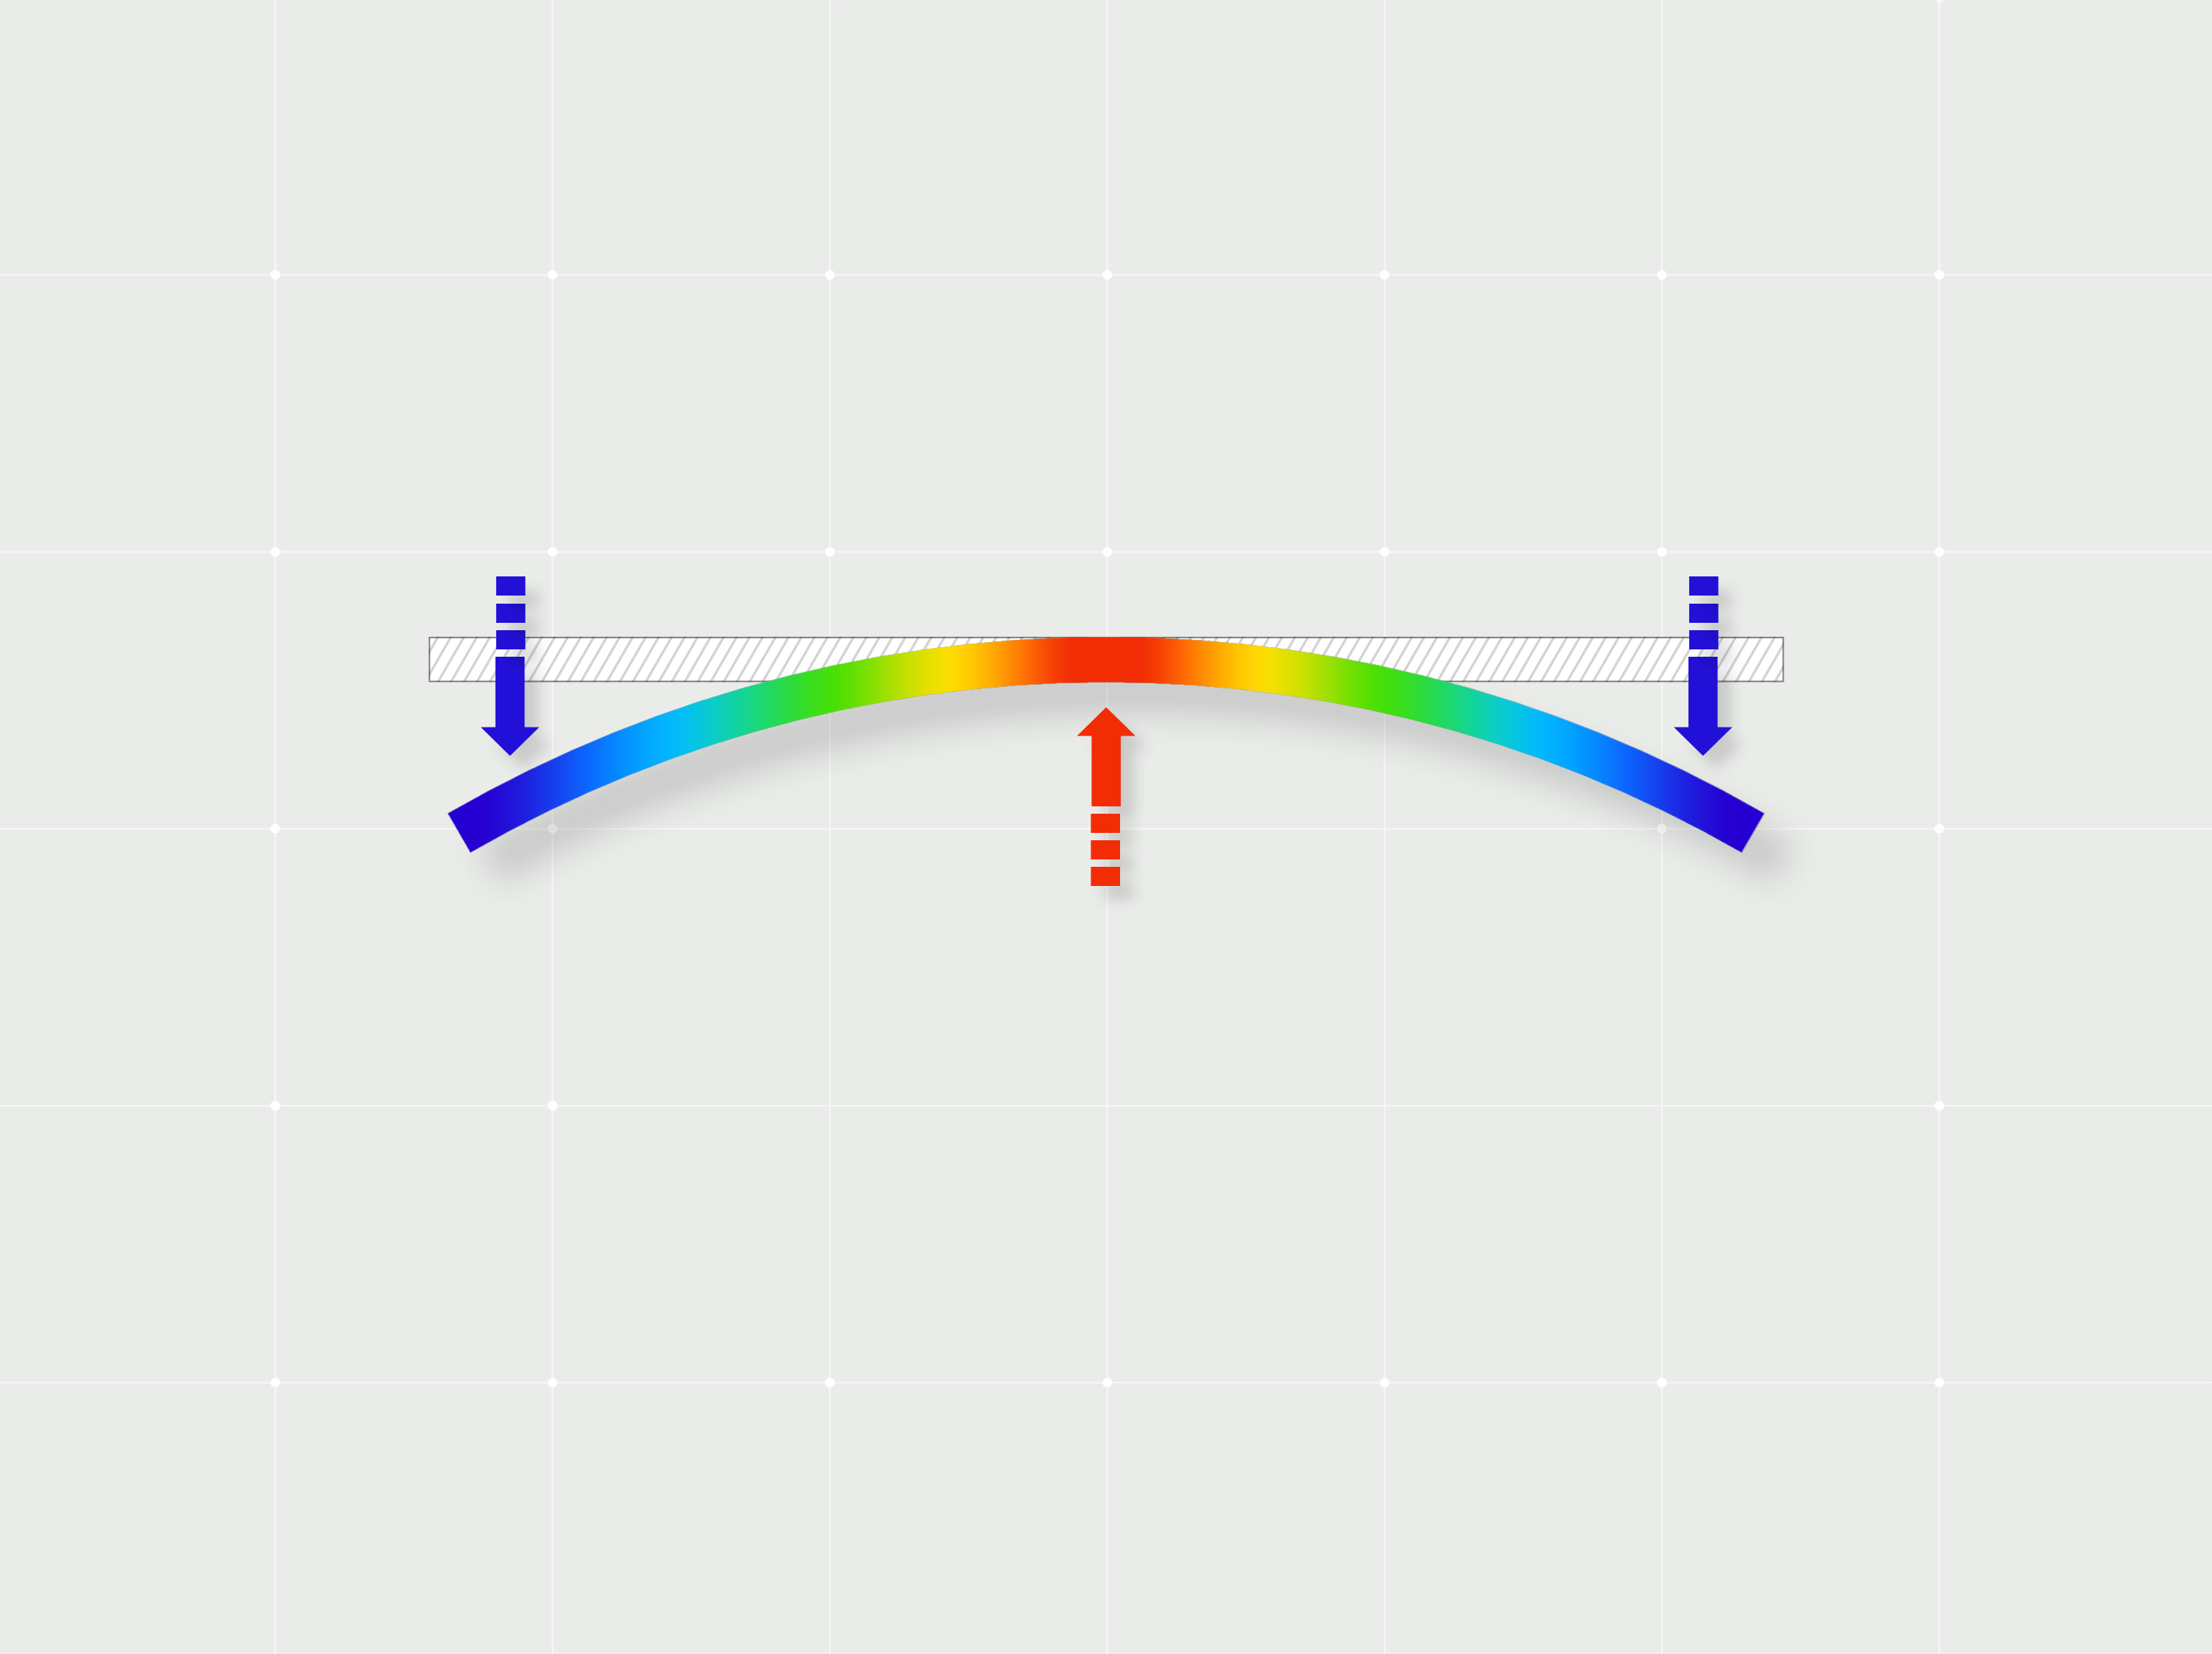
UČINEK TEMPERATURE FORME NA NAPETOSTI
Vsi oblikovani deli vsebujejo napetosti, nastale med brizganjem.
Temperatura forme in hlajenje pomembno vplivata na končne napetosti in trdnost dela v obratovanju
Na splošno visoke temperature forme dajejo manjše napetosti in deli, proizvedeni pri nizkih temperaturah forme, bodo bolj nagnjeni k napakam.
Notes:
This is why the temperature control of the mould is essential and we must ensure the right balance to have a perfect production with excellent part quality.

Slide 9
COOLING PROCESS
VS CYCLE TIME
A Optimum Injection Time
B Packing Time
C Optimum Cooling Time
D Mould Open
E Ejection Forwards
F Robot Part Removal Time
G Ejection Back
H Mould Close
I Dwell
The cooling time of the part can account for a large amount of the overall cycle time.
The example below shows a cooling time which is 40% of the overall cycle time.
Notes:
Cooling is usually from 30-70 % of the overall cycle time.

Slide 10
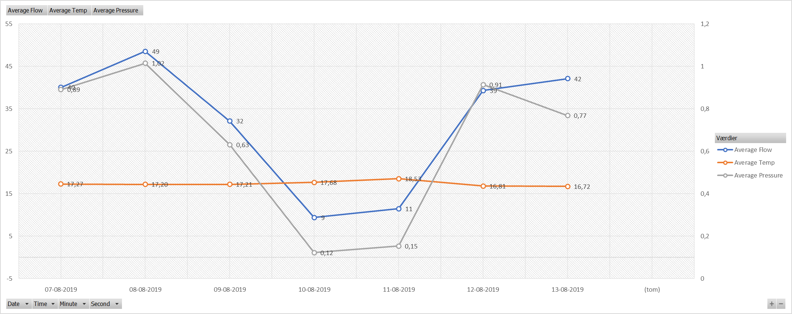
Pretok vs Energija
Najdite pravo razmerje med zadovoljivim pretokom
in prihranjeno energijo in preprečite preveliko ohladitev
Notes:
As mentioned – some competitors looks at flow as the major factor, but big and turbulent flow is not always the target.
We also see many moulders over-cooling. This has a huge cost related to pump capacity and energy. This graph shows that by reducing flow by more than 50 %, the return temperature is only effected by 1,26 ° C. The customer could save 40 % pump energy without increasing cycle time.

Slide 11
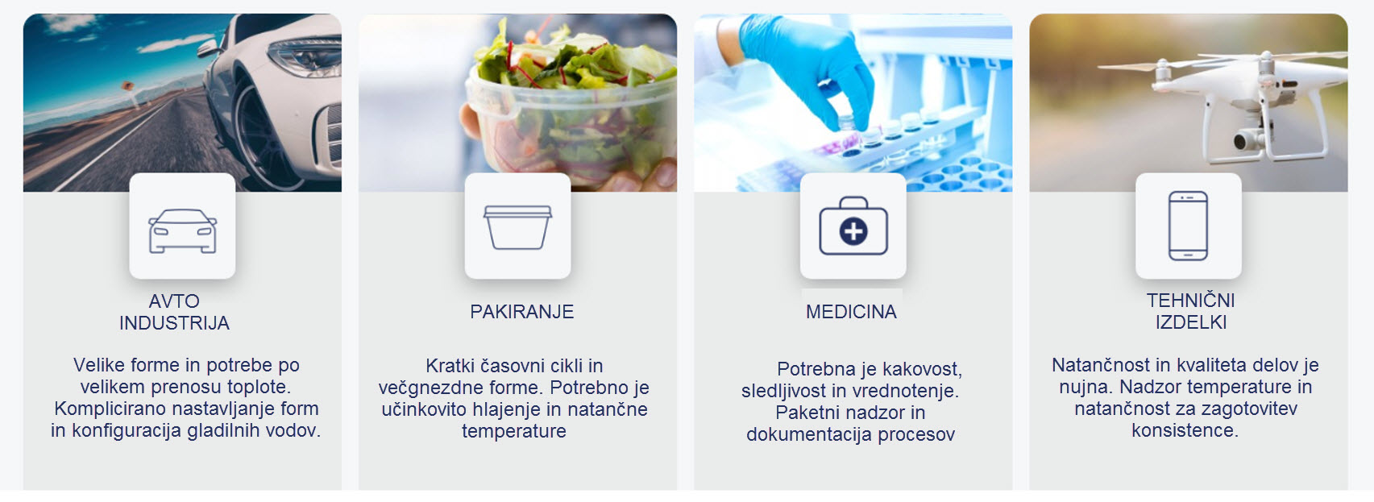
Marketinški segmenti
Notes:
All plastic processing industries can benefit from monitoring and optimizing cooling water, to ensure higher quality and more efficient and consistent production, eliminating faulty parts and lost production capacity.

Slide 12
Flosense nabor
Enojni tokokrog Večkratni tokokrog
Flosense 1.0 Flosense 3.0 & 4.0
Notes:
Today, we are focusing on 2 applications:
Single circuit monitoring (Flosense 1.0) and Multi line monitoring (Flosense 3 & 4)

Slide 13
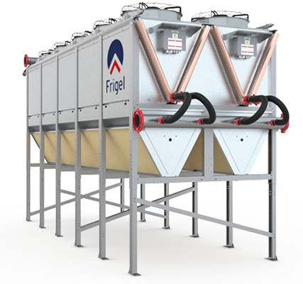
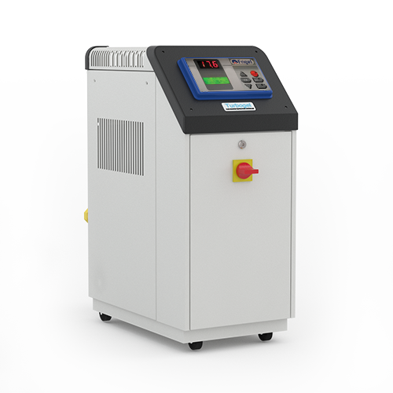
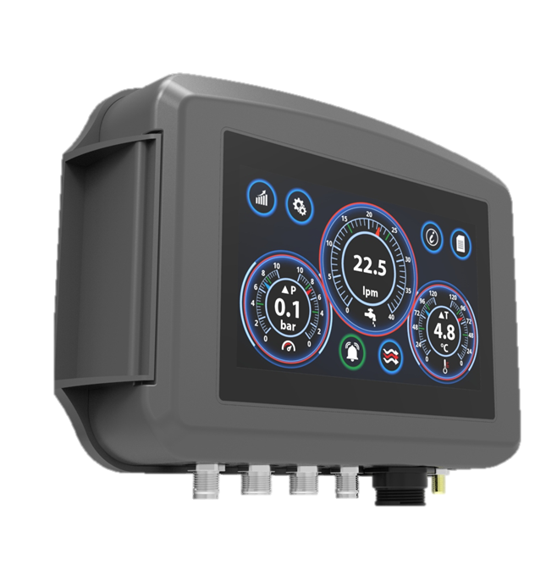
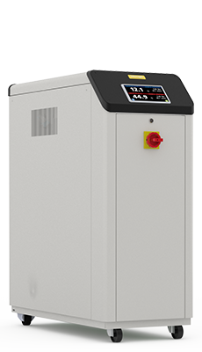
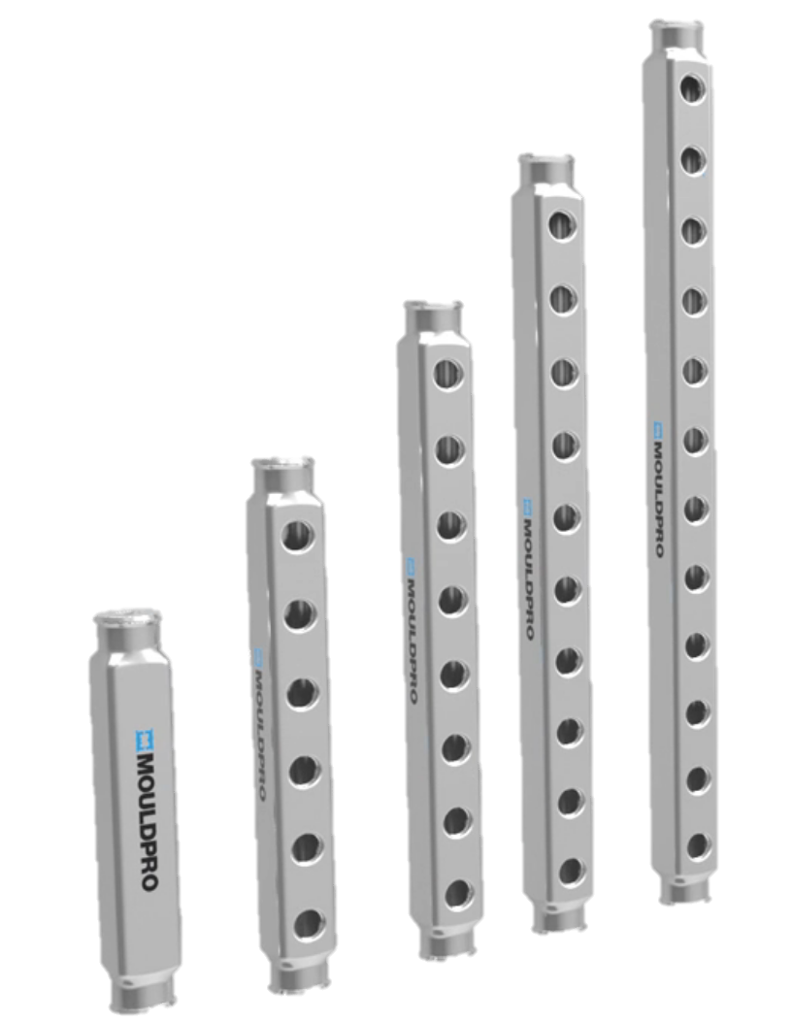
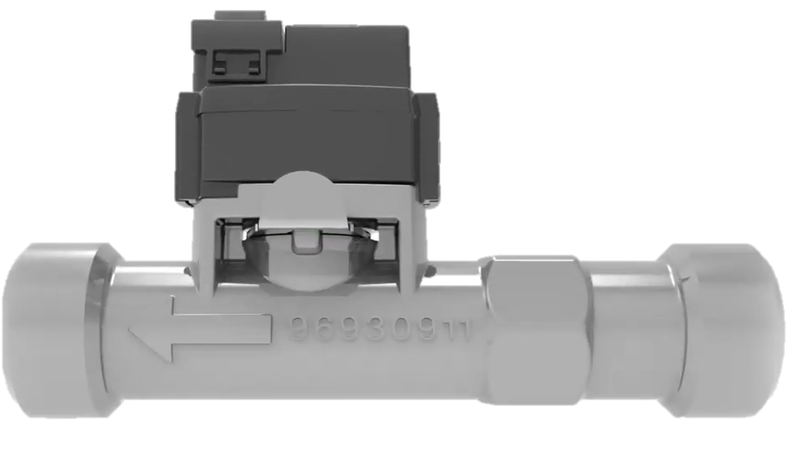
Flosense aplikacija Flosense 1.0
Flosense 1.0
Centralni hladilni vodi
Temperaturne kontrole
Mobilni hladilniki
Distribucijski razdelilniki
Notes:
Flosense 1.0 is ideal for individual flow lines, to ensure stability in the process. This is highly recommended, as we have seen from studies that the set temperatures and specified flow capacity is far from reality. Flosense will monitor pressure, flow and temperature as well as Delta T and Delta P.

Slide 14
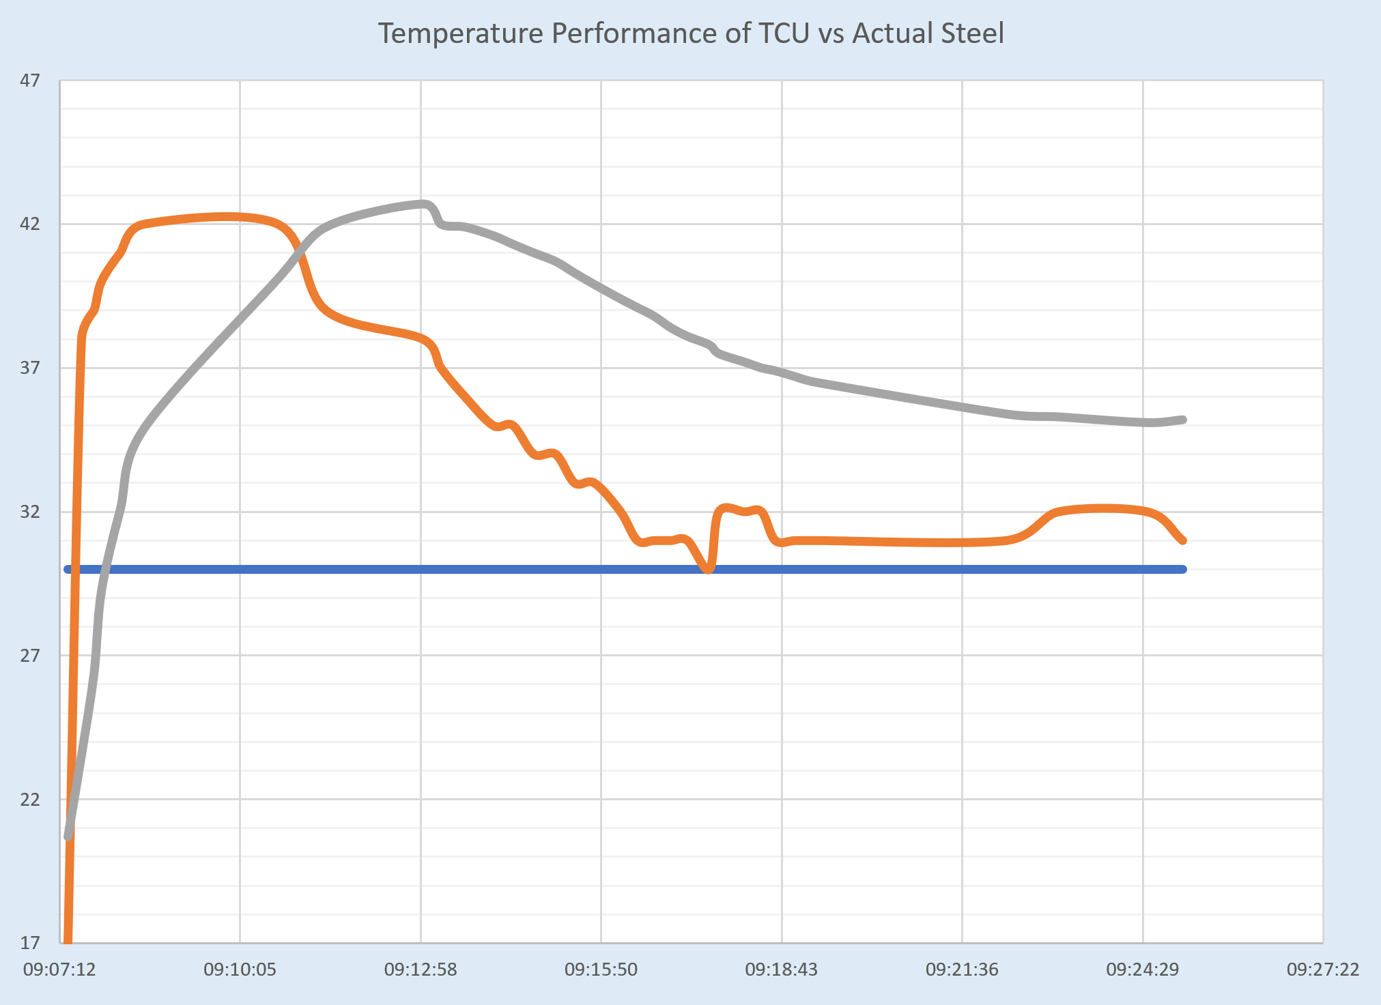
Kontrola temperature
Nastavljena temperatura
Dejanska temperatura
Temperatura forme
Notes:
When we control the mould temperature, we set the required value, check when the controller says it is stable and then start moulding.
The graph shows that the temperature of the controller takes a long time to settle. In this case, the actual temperature (orange) is always higher than the set temperature (blue).
The grey line shows the actual mould temperature. Note the time to settle and the actual temperature vary dramatically from the set temperature.

Slide 15
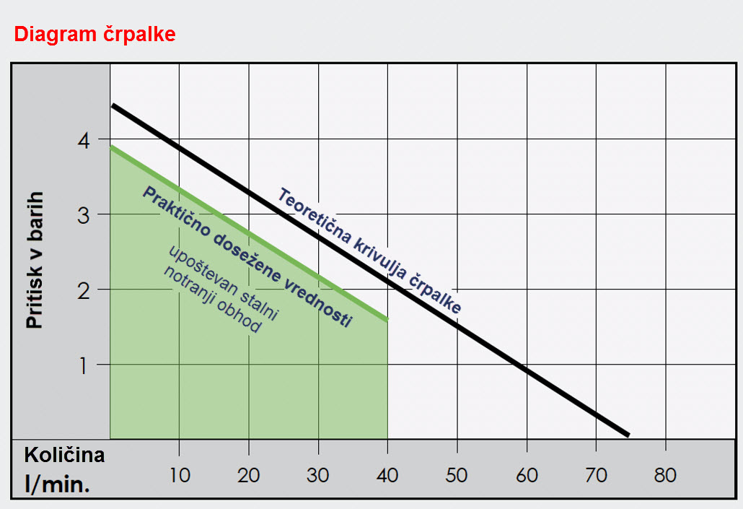
Pretok proti zmogljivosti črpalke
Notes:
This diagram is from a basic temperature control and it is specified for 75 l/m, but reading the pressure axis, it is clear that you can only reach 75 l/m if you pump directly into the drain.
Once you install pipes, you will see that the maximum flow rate cannot exceed 40 l/m and when couplers and fittings are connected to the mould you will see a flow drop to 25 l/m.
Only premium and expensive units are equipped with flow meters and still not measuring delta T or Delta P.

Slide 16
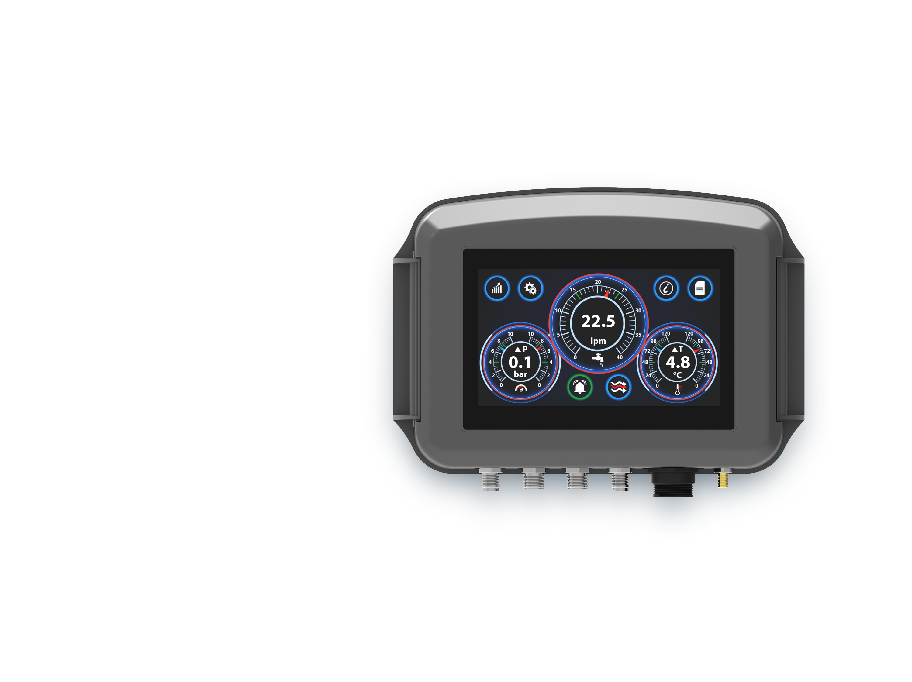
MERJENJE
ENOJNEGA TOKOKROGA
Tipična aplikacija:
Grelec vode (TCU)
Hladilnik
Kritični kanal
Kontrolni instrument
FLEKSIBILEN NADZOR PRETOKA

Slide 17
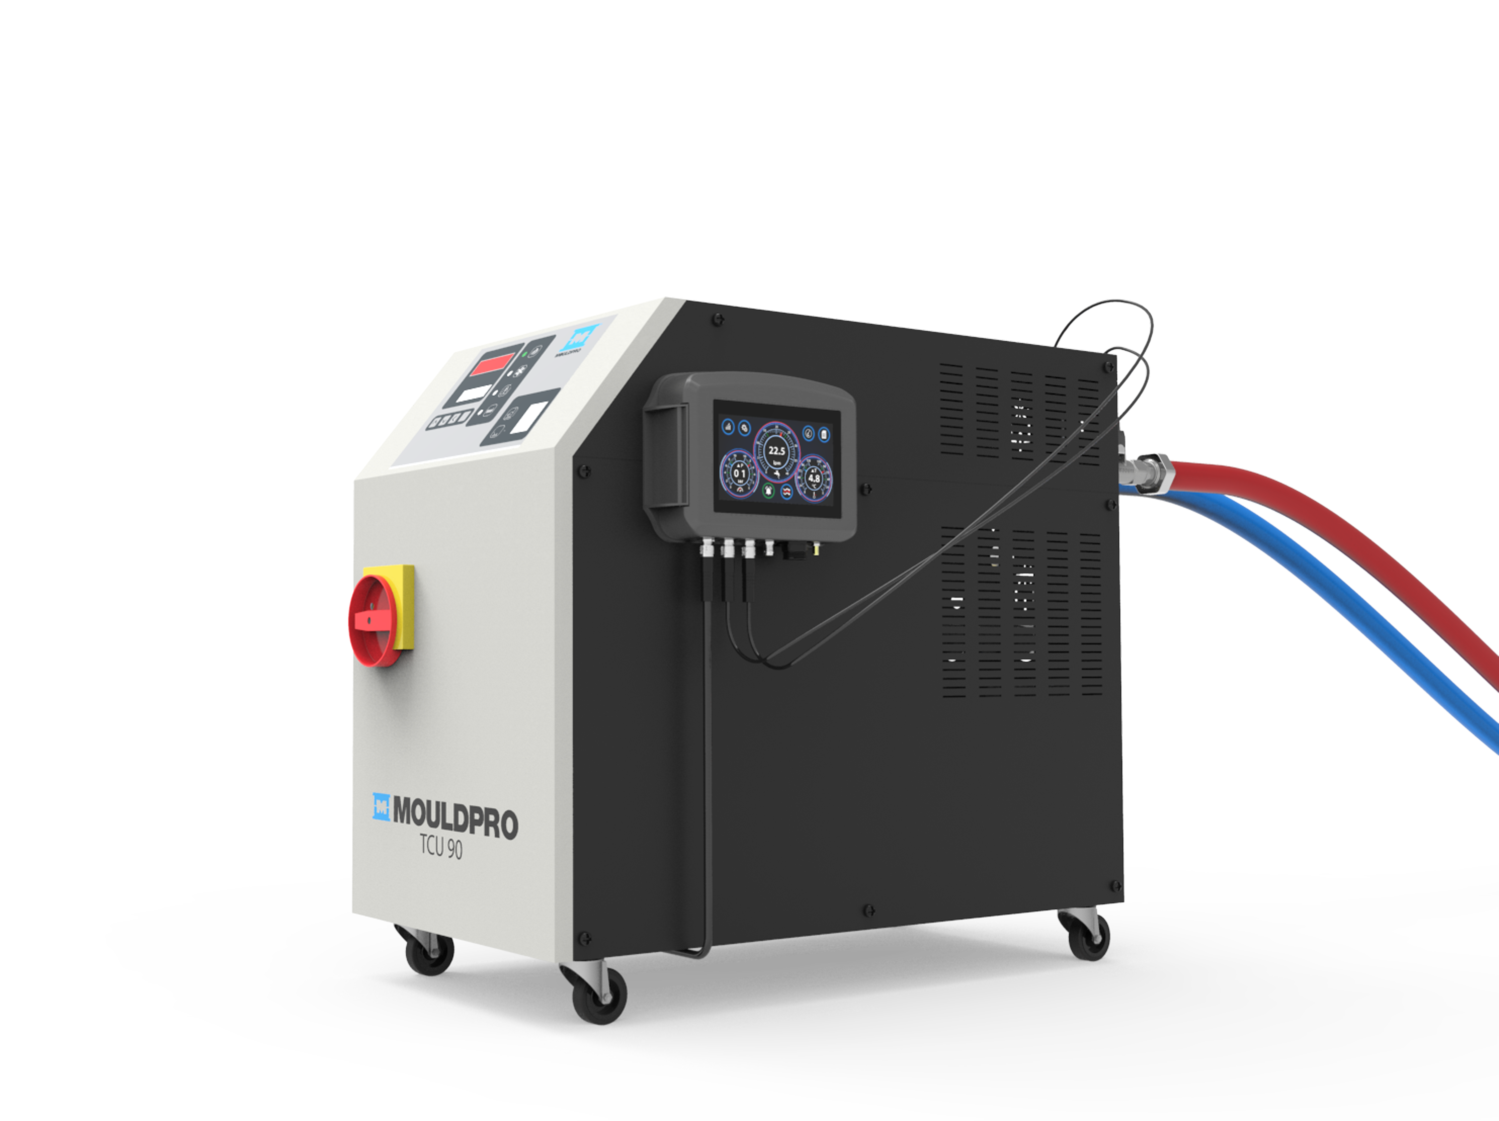
MONTAŽA HAPRAVE
FLEKSIBILEN NADZOR PRETOKA

Slide 18
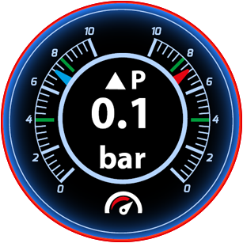
DELTA P
Delta P
Izguba pritiska nastane zaradi cevi, priključkov in ventilov in vpliva na produktivnost.
Razlika med vhodnim in izhodnim pritiskom se meri kot Delta P.
Nihanje Delta P lahko kaže na okvaro črpalke, blokirano vodno pot, puščanje itd.
FLEKSIBILEN NADZOR PRETOKA
Notes:
As mentioned: Flosense focus’ on variations in the flow from pump outlet through the process and back to the return inlet.
Many customers are not aware that small hoses will create massive pressure drop, which means flow drop.

Slide 19
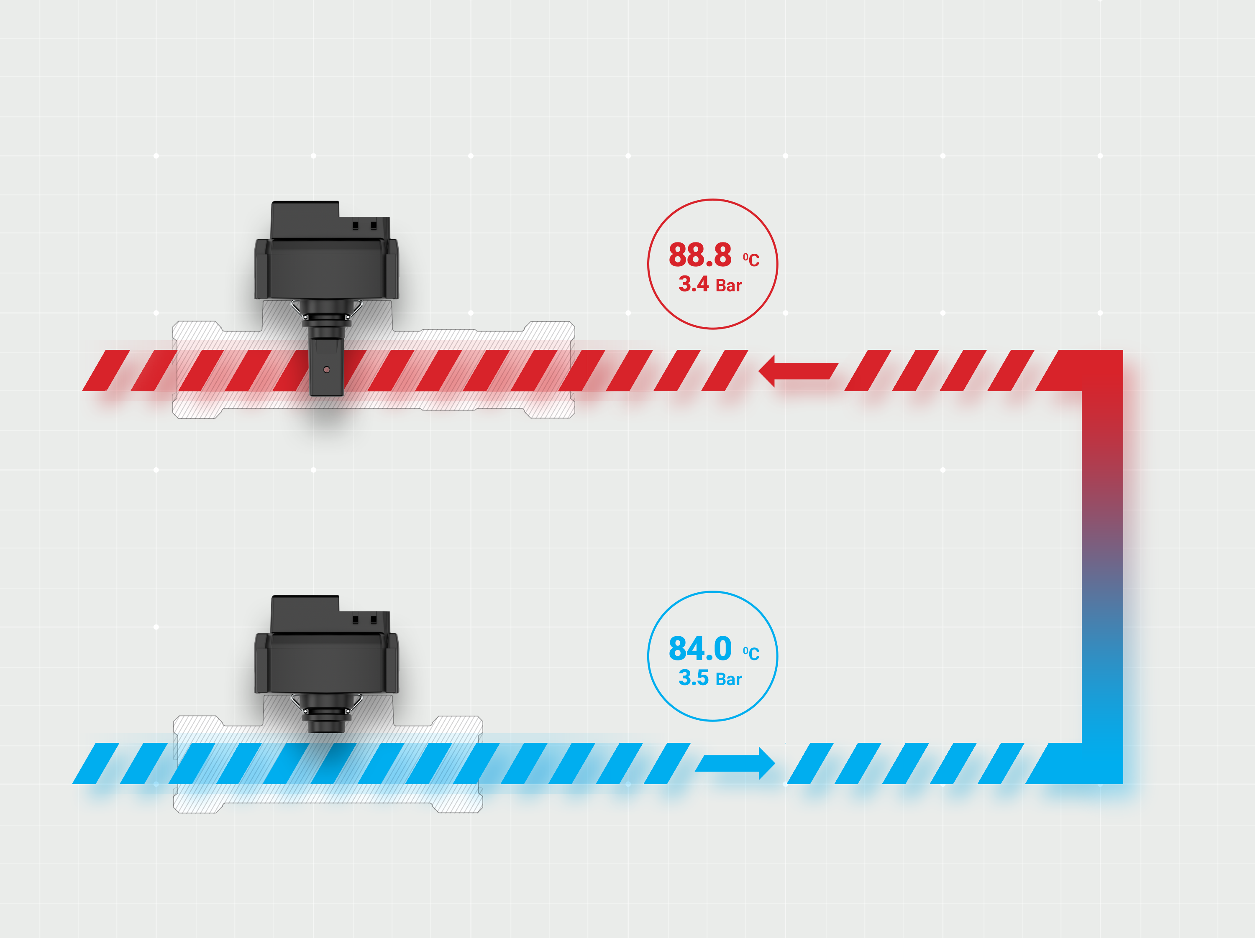
POVRATNI IN VHODNI
SENZOR
Povratni
senzor
Povratek iz procesa
Process
Vhodni
senzor
Dovod v proces
FLEKSIBILEN NADZOR PRETOKA

Slide 20
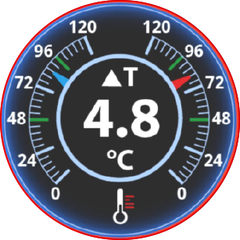
DELTA T
Delta T
Ko hladilna voda prehaja skozi kalup, prenaša toploto iz jekla v hladilno vodo. Čim močnejši je pretok, tem učinkovitejši je postopek hlajenja.
Razlika med vstopno temperaturo in temperaturo povratka se meri kot Delta T.
Nenadno nihanje Delta T lahko povzroči napačen grelec / hladilnik, blokiran kanal, povečanje obsega itd.
FLEKSIBILEN NADZOR PRETOKA
Notes:
Delta T is the most critical factor and very important to monitor. A stabile Delta-T means stabile production.

Slide 21
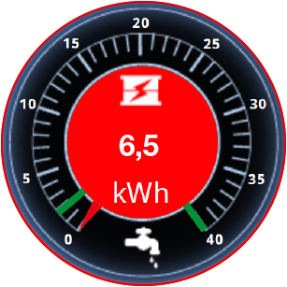

PRENOS ENERGIJE IN
INDIKATOR TURBULENTNEGA TOKA
Flosense, zagotavlja vidnost ključnih meritev hladilnega kroga, izboljšuje učinkovitost, povečuje produktivnost in dobičkonosnost.
Kazalnik prenosa energije
Toplota se iz forme prenaša skozi vodne kanale, Flosense
izračuna prenos toplote kot energijske enote BTU ali kWh.
Ta funkcija ponazarja učinkovitost procesa.
Kazalnik turbulence pretoka
Flosense je opremljen z kazalnikom turbulence pretoka, ki velja za ključni indikator učinkovitosti hladilnega tokokroga. Enota bo pokazala laminarni, prehodni in turbulentni pretok ter spremljanje Reynoldsove številke, ki temelji na premeru pretoka in odstotku glikola v sistemu.
Izboljšanje pretoka od laminara do turbulenta lahko poveča učinkovitost prenosa toplote do 500%.
FLEKSIBILEN NADZOR PRETOKA
Notes:
Flosense have all the basic information and smart functions to give the operator detailed information about the efficiency in the process and how the heat transfer is proccesing.

Slide 22

ALARM
Flosense, ponuja funkcije in vmesnike za spremljanje, analiziranje in preverjanje podatkov, ki so bistveni za vašo produktivnost in kakovost.
Alarm
S programabilnimi omejitvami alarma na pretoku, temperaturi in tlaku lahko vsako spreminjanje vrednosti, ki se spremlja, sproži alarm na zaslonu. Zunanji alarmni izhodni signal se lahko priključi na pomožno opremo, ki je lahko vizualni ali slišni signal, grelnik kalupov ali stroj za brizganje.
Tudi v primeru „poškodbe cevi" bo enota zaznala nenadno izgubo tlaka in enoto je bodisi mogoče povezati z alarmom ali pa jo uporabiti za samodejni izklop grelnika forme.
FLEKSIBILEN NADZOR PRETOKA

Slide 23


ZAPISOVANJE PODATKOV
IN IZVOZ
Zapisovanje podatkov
Podatki se snemajo in so shranjeni v notranjem pomnilniku, od koder so lahko prikazani za preteklih 30 dni.
Pretok, temperatura in tlak se beležijo in si jih lahko ogledate na grafičnem zaslonu.
Zadnjih 30 dni podatkov je posnetih in so shranjeni v internem spominu memory.
Izvoz podatkov
Podatke je mogoče za nadaljnjo analizo prenesti tudi na prenosnik s pomočjo integriranega USB vhoda.
Podatki so shranjeni v tekstovnem formatu in jih je mogoče analizirati z uporabo excela ali druge programske opreme za analizo.
FLEKSIBILEN NADZOR PRETOKA

Slide 24
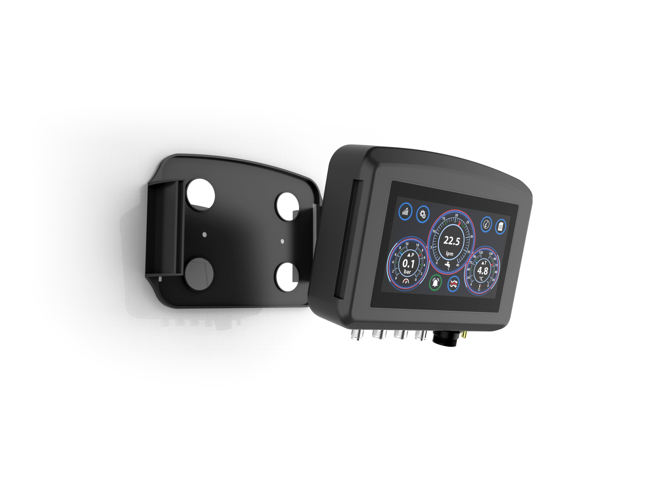
MAGNETNI NOSILEC
Magnetni
nosilec
4.3” zaslon
na dotik
FLEKSIBILEN NADZOR PRETOKA

Slide 25
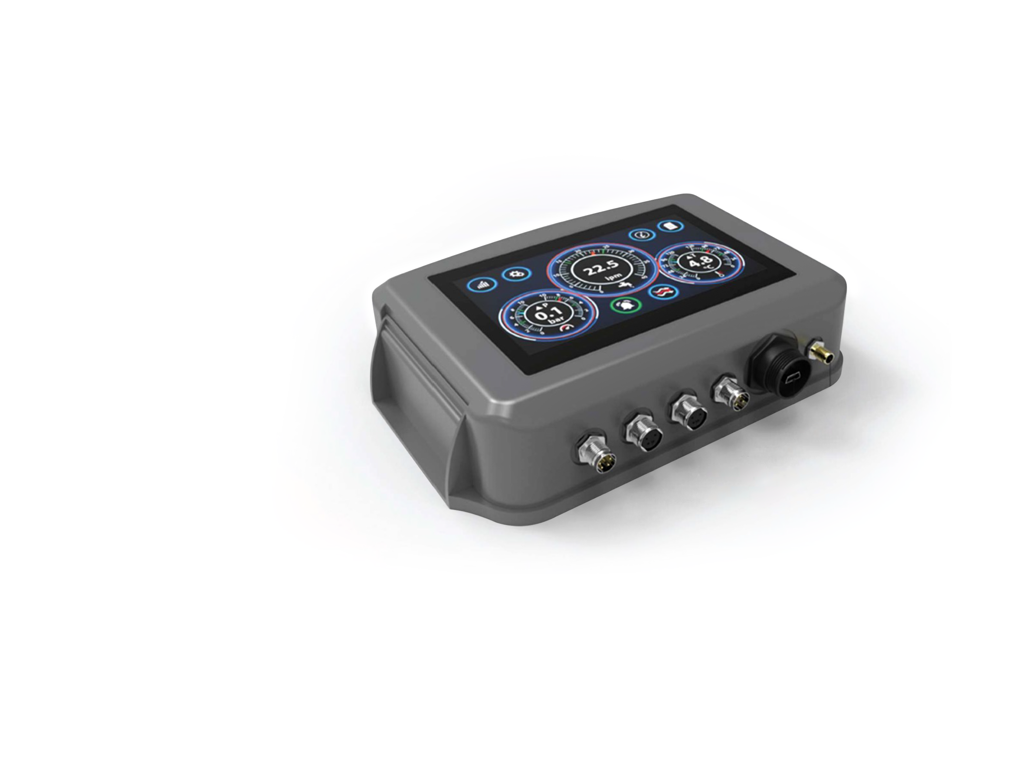
PRIKLJUČKI
Električni priključki
1. Alarm
2. Sensor 2 (senzor pritiska)
3. Sensor 1 (senzor pretoka)
4. Napajanje vhod
5. USB
6. Zemlja
1.
2.
3.
4.
5.
6.
FLEKSIBILEN NADZOR PRETOKA

Slide 26
ZASLONSKI PRIKAZOVALNIK
Grafični prikaz
FLEKSIBILEN NADZOR PRETOKA

Slide 27
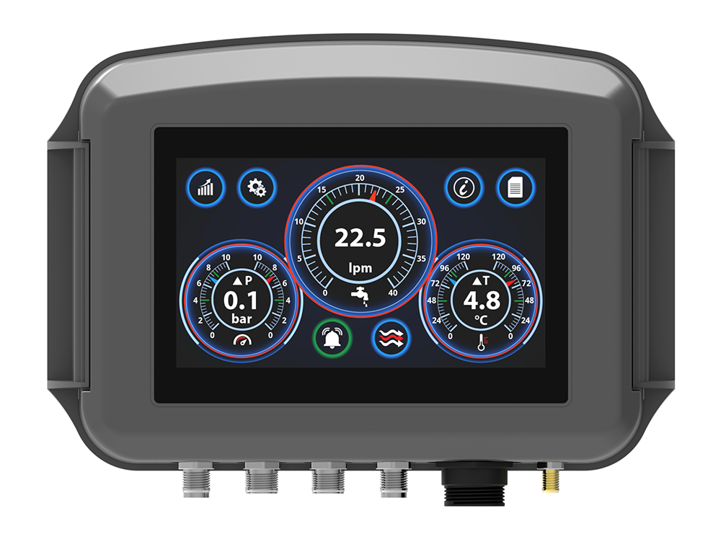
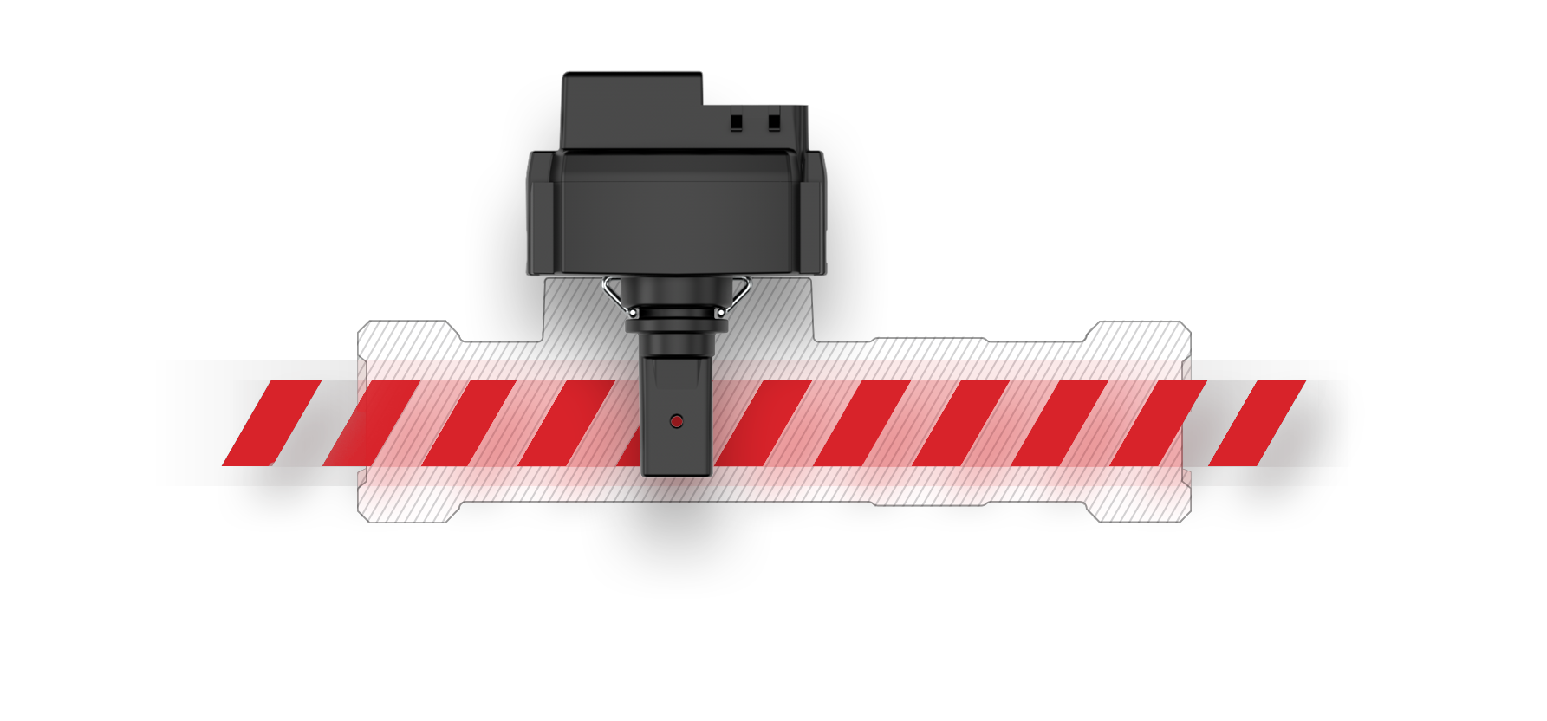
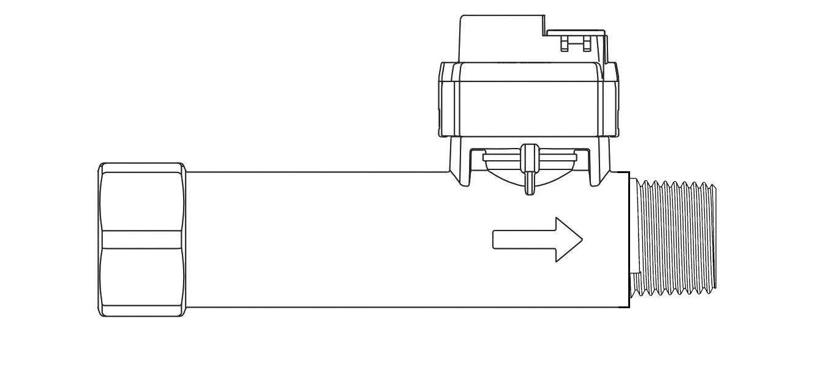
ZASLONSKI PRIKAZOVALNIK
Senzorski komplet za enojni pretok
Nov senzor nizkega pretoka prihaja v Q3
0,6 – 12 l/m (0.6 -3,17 gpm)
C
B
D
A
Pretočni kanal < 13 mm (1/2”)
FLEKSIBILEN NADZOR PRETOKA
Notes:
We delveloped a new sensor so we can now support flow applications with small diameters, smaller than 13 mm. The new sensors only measure temperature and Flow. The pressure is not measured from this sensor and Delta-P cannot be measured using the FSE type sensor.
The new sensor is less sensitive to noise and when measuring low flow, the eddy current in the water is very weak and noise normally makes it impossible to measure low flow. This has been solved by removing the pressure measurement from the sensor.

Slide 28
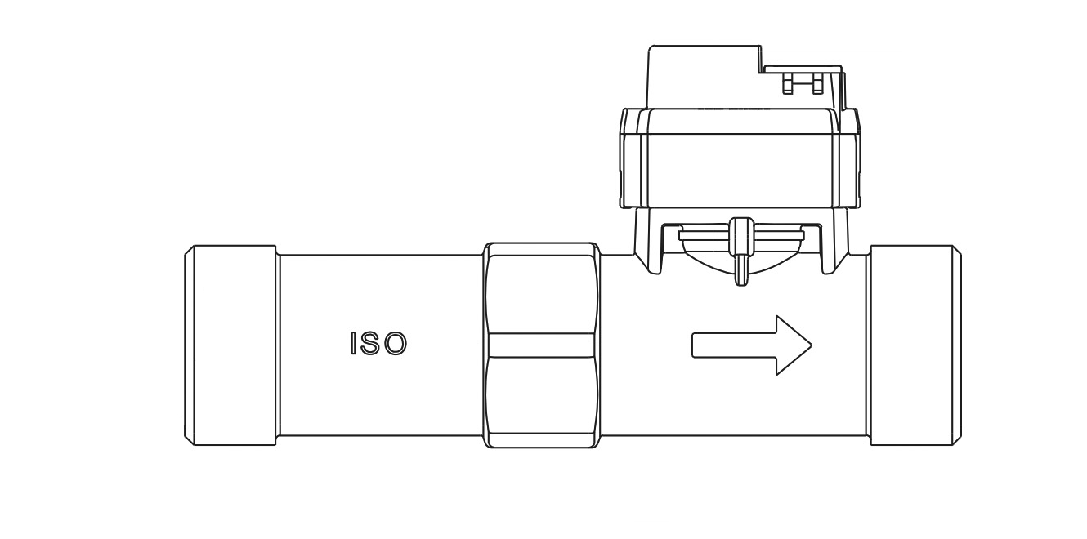
ZASLONSKI PRIKAZOVALNIK
Enojni multisenzorski komplet
C
2x B
A
Pretočni kanal => 19 mm (3/4”)
FLEKSIBILEN NADZOR PRETOKA
Notes:
The existing types are all engineered for flow channels > 19 mm. and available as single Multi Sensor Kit or Dual Sensor Kit.

Slide 29
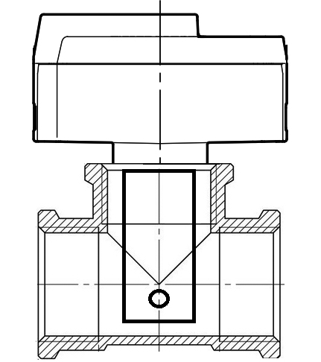
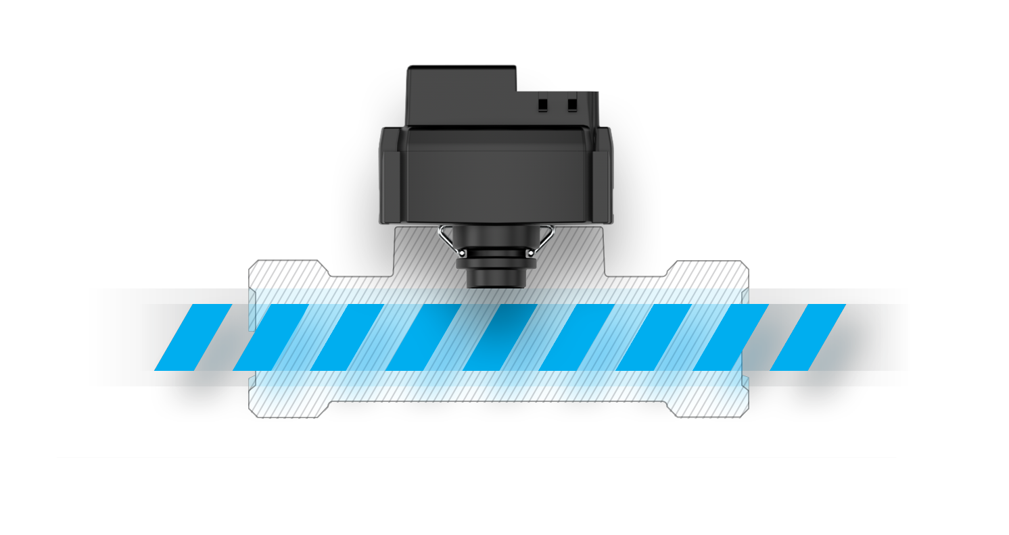
ZASLONSKI PRIKAZOVALNIK
Dvojni multisenzorski komplet
B
C
2x B
A
Pretočni kanal=> 19 mm (3/4”)
FLEKSIBILEN NADZOR PRETOKA
Notes:
This edition is with 2 sensors (Feed and Return) on the same circuit.

Slide 30
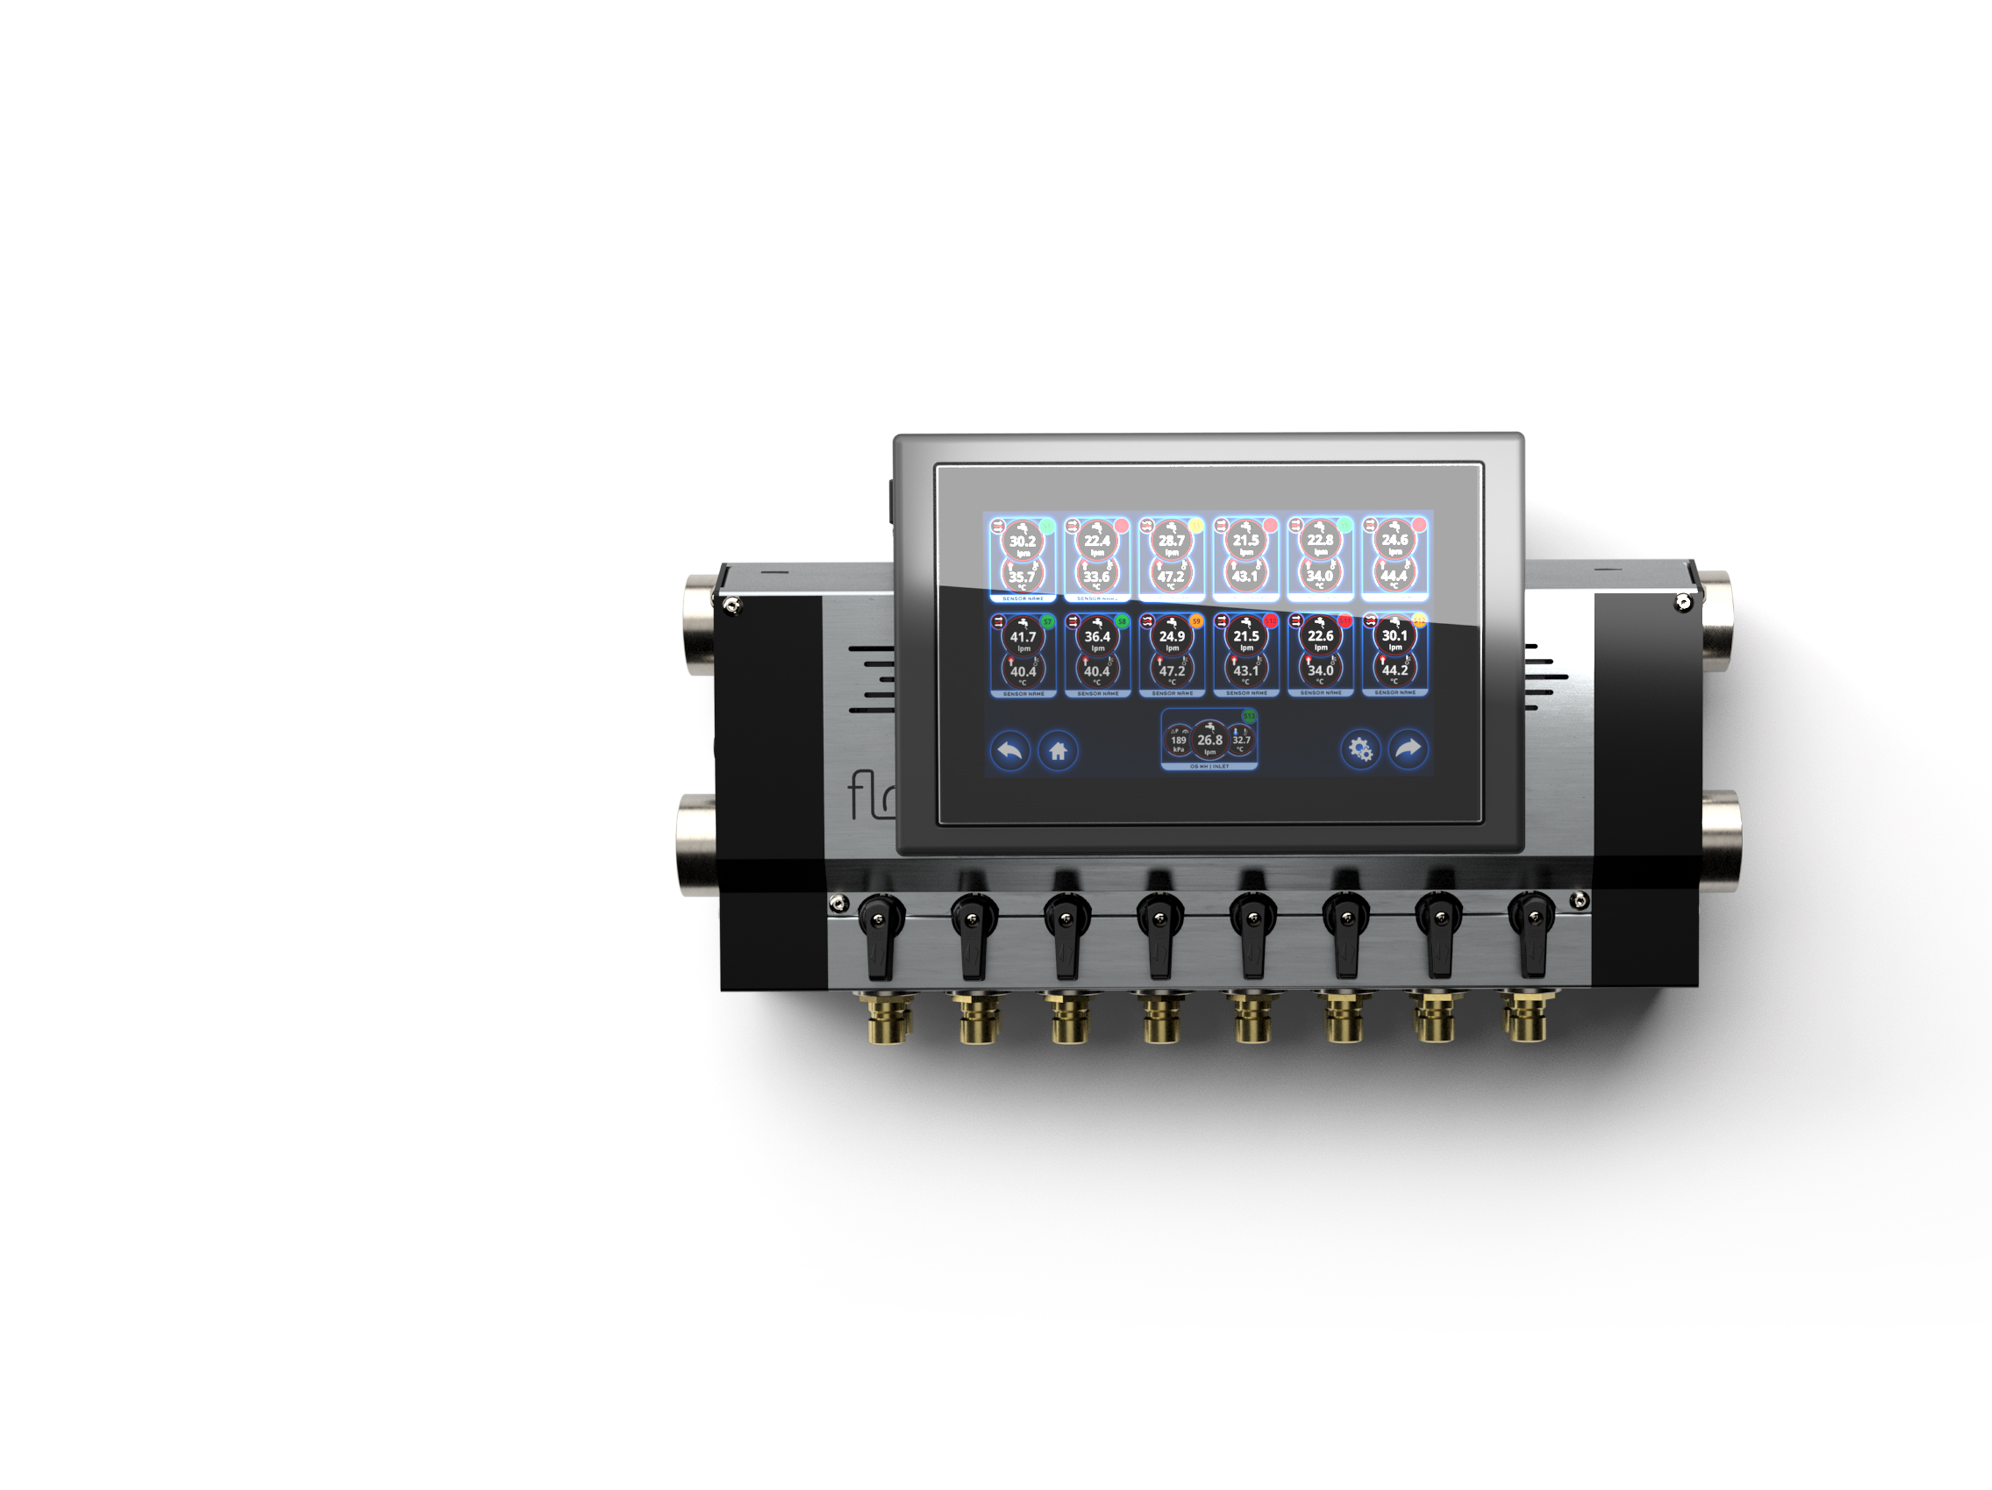
Fiksna pritrditev zaslona / Enojni razdelilnik
Kompletna enota
s senzorjem pritiska
na glavnem vhodu.
Notes:
The New Kid on the Block!
First Flosense 3.0 – this is designed to replace traditional water flow regulators that we see on the majority of the new machines sold on the market. Biggest supplier is Wittmann.
Our digital flow regulator is an ultra compact unit with all the features known from flow regulators, just with essential functions and features.

Slide 31
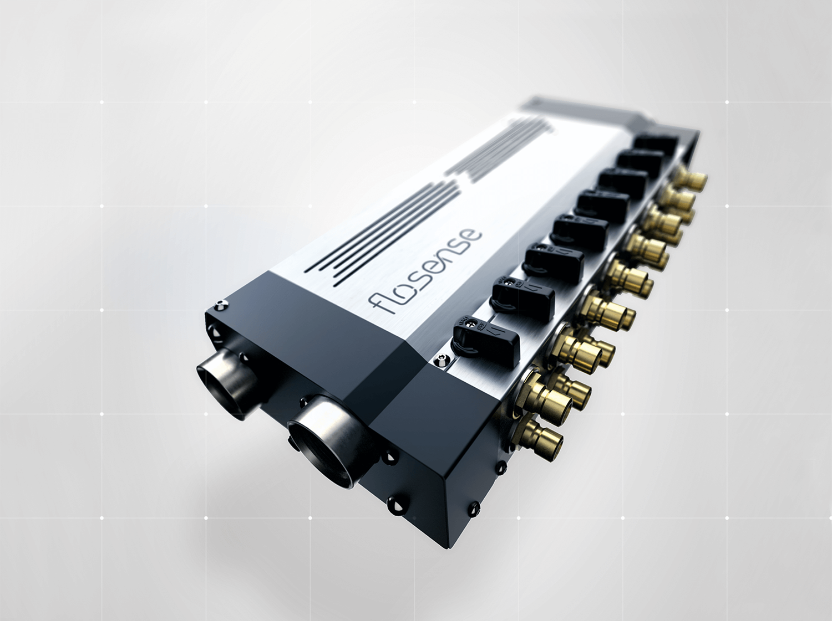



Kompletna enota s senzorjem pritiska na glavnem vhodu / izhodu
Notes:
Flosense 3 and Flosene 4 share the same manifold technology. Only difference is that 3.0 has an integrated screen and 4.0 is designed with a separate screen to connect multiple manifolds.
The Manifold is unique offering new technology and state of the art design and performance. Let’s look inside…

Slide 32
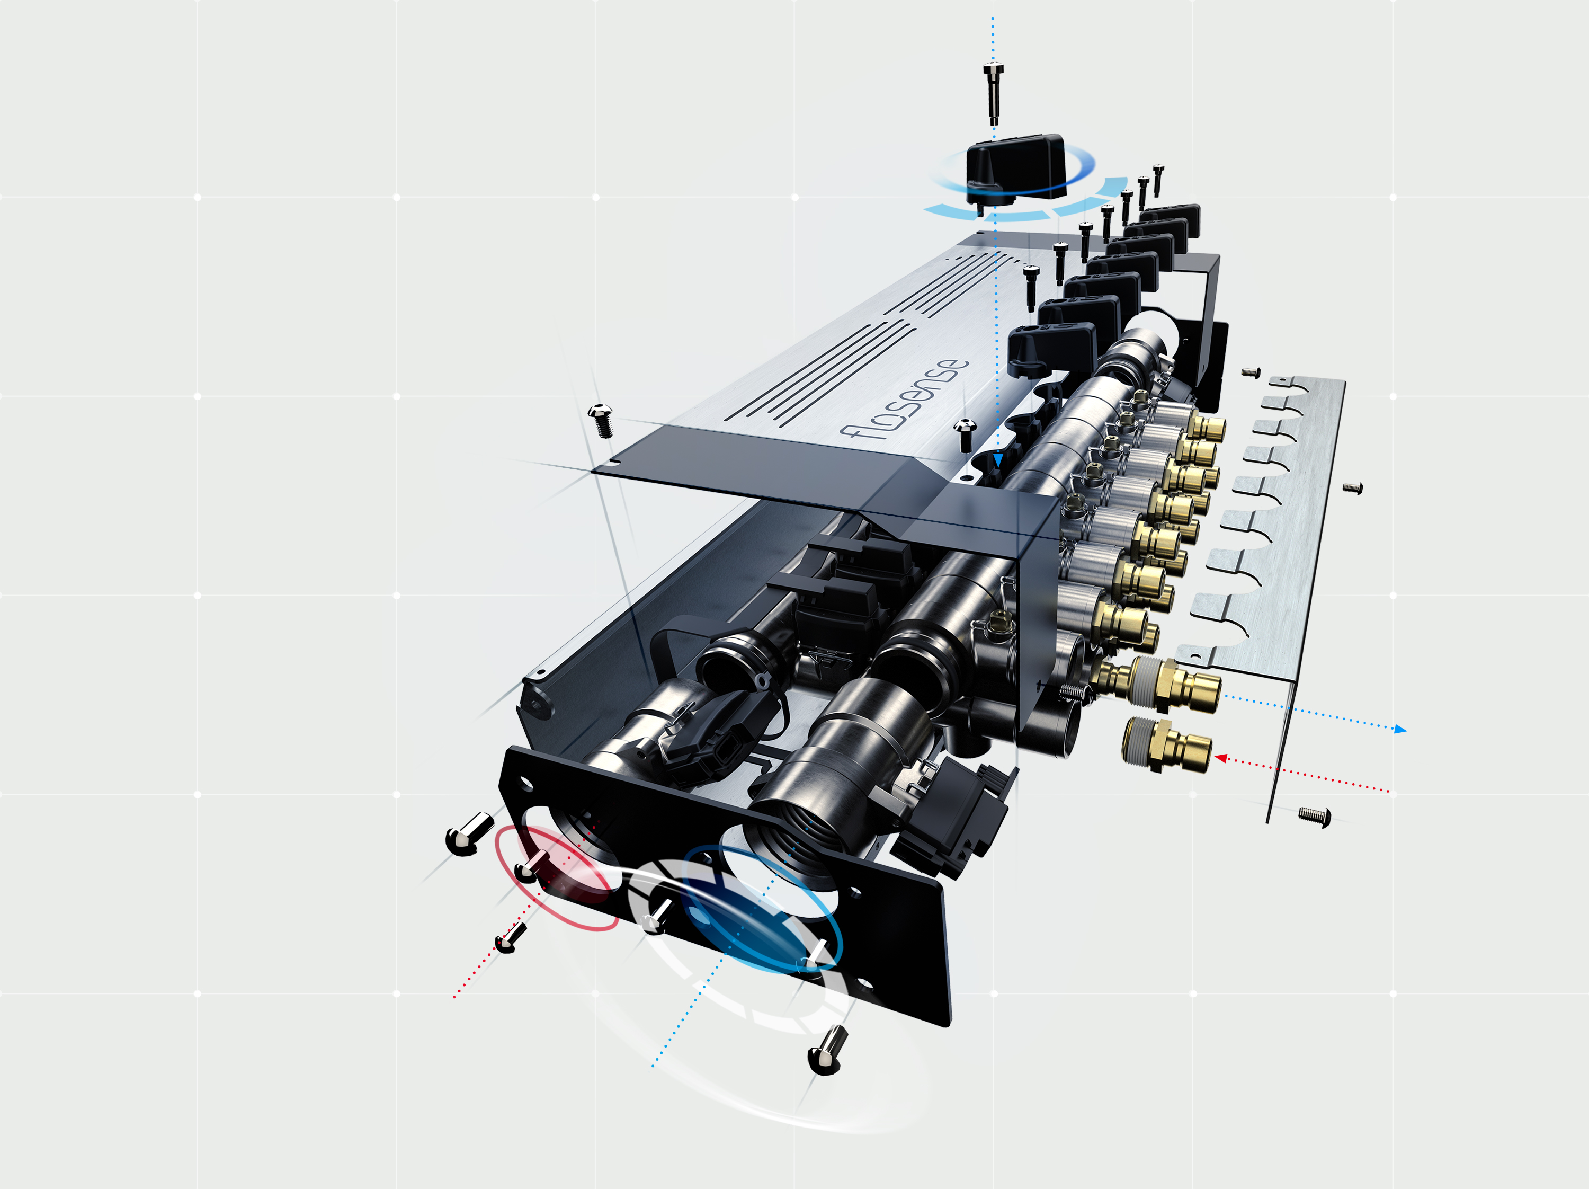
INTELIGENTNI
SISTEM
NADZORA
PRETOKA
Notes:
The manifold is made in modules which are forged one-piece design. The material is Nickel plated DZR Brass. DZR Brass is corrosion resistant brass used for corrosive and HARSH ENVIRONMENTS
Such as coolant water. Normal brass is significantly more resistant to corrosion than Aluminium. Standard brass alloy consists of zinc and copper and can be attacked by corrosive liquid eating the zinc. Dezincification selectively removes zinc from the alloy leaving behind a porous, copper-rich structure that has little mechanical strength.
The DZR brass consists of a maximum of 15 % zinc and the alloy has similar resistance grade as Stainless steel.
The manifold is equipped with flow/temperature sensors on each return feed, but also pressure/temperature sensors in the main feed and the main oulet. All wrapped in a compact design.

Slide 33
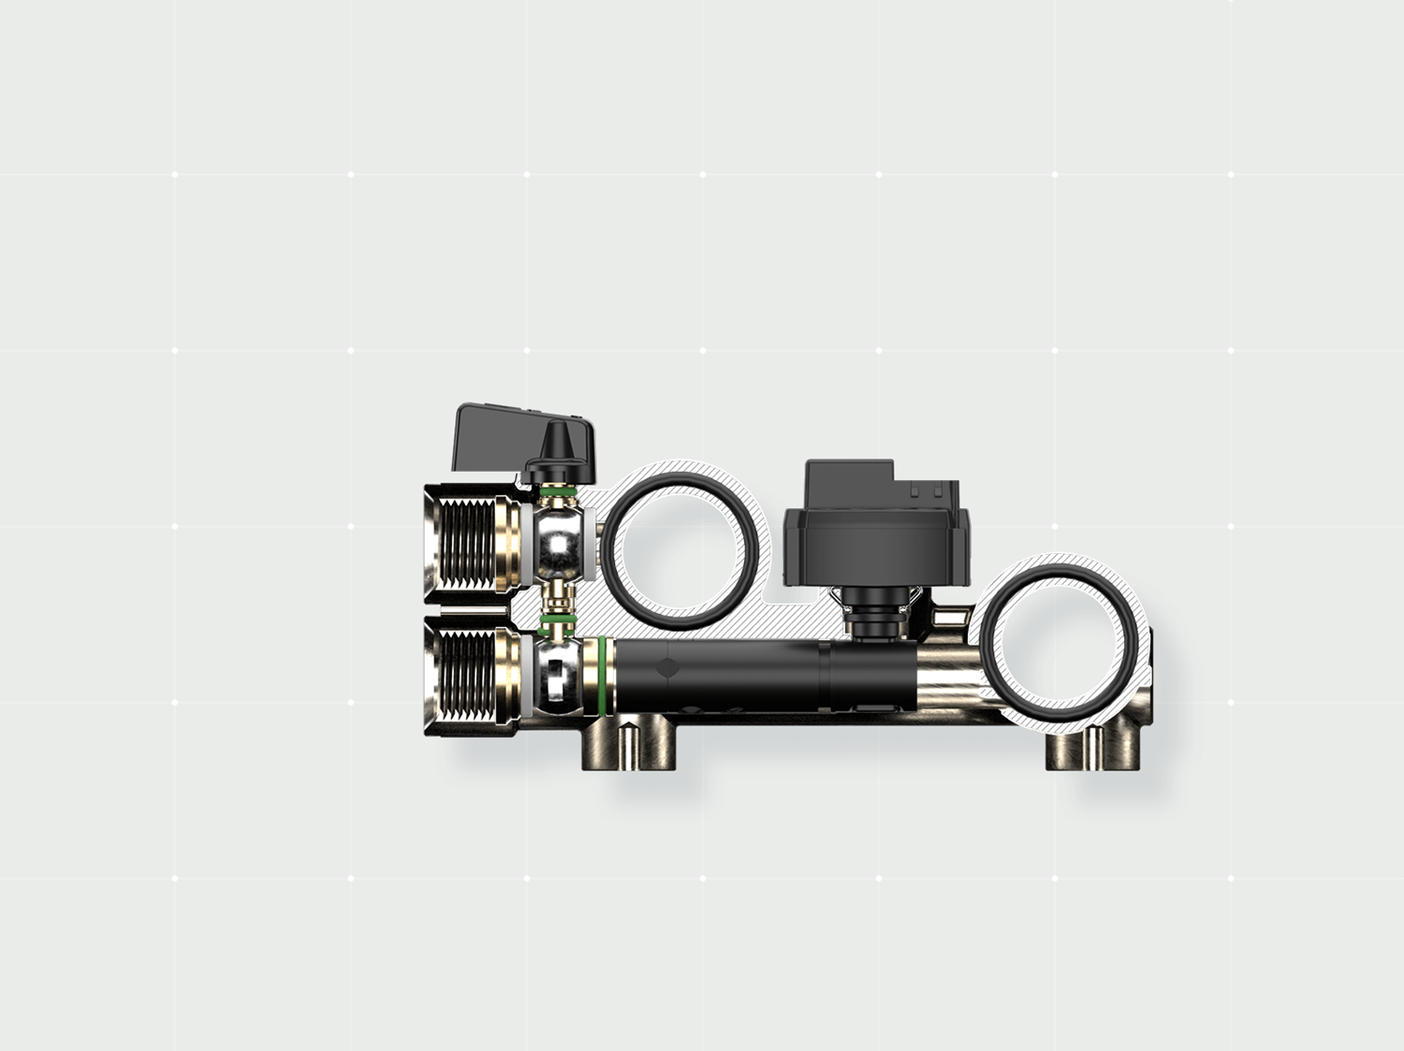
Dvojni krogljični ventil
Pretok / temperatura senzor
Dotok
Odtok
Dvojni
krogljični ventil
Pretočni priklj.
Povratni priklj.
Vložek
pretočne cevi
Notes:
The modules are made with two integrated regulation valves, which are dually activated. This saves space allowing the pitch lenghts (between ports) to a minimum. The forged one-piece design illiminates leakages and is resistant to high temperatures.

Slide 34
Fiksna pritrditev zaslona / Enojni razdelilnik
Kompletna enota
s senzorjem pritiska
na glavnem vhodu.
Notes:
Going back to Flosense 3.0 Digital flow regulator. Let’s compare with the Wittmann Style regulator.

Slide 35
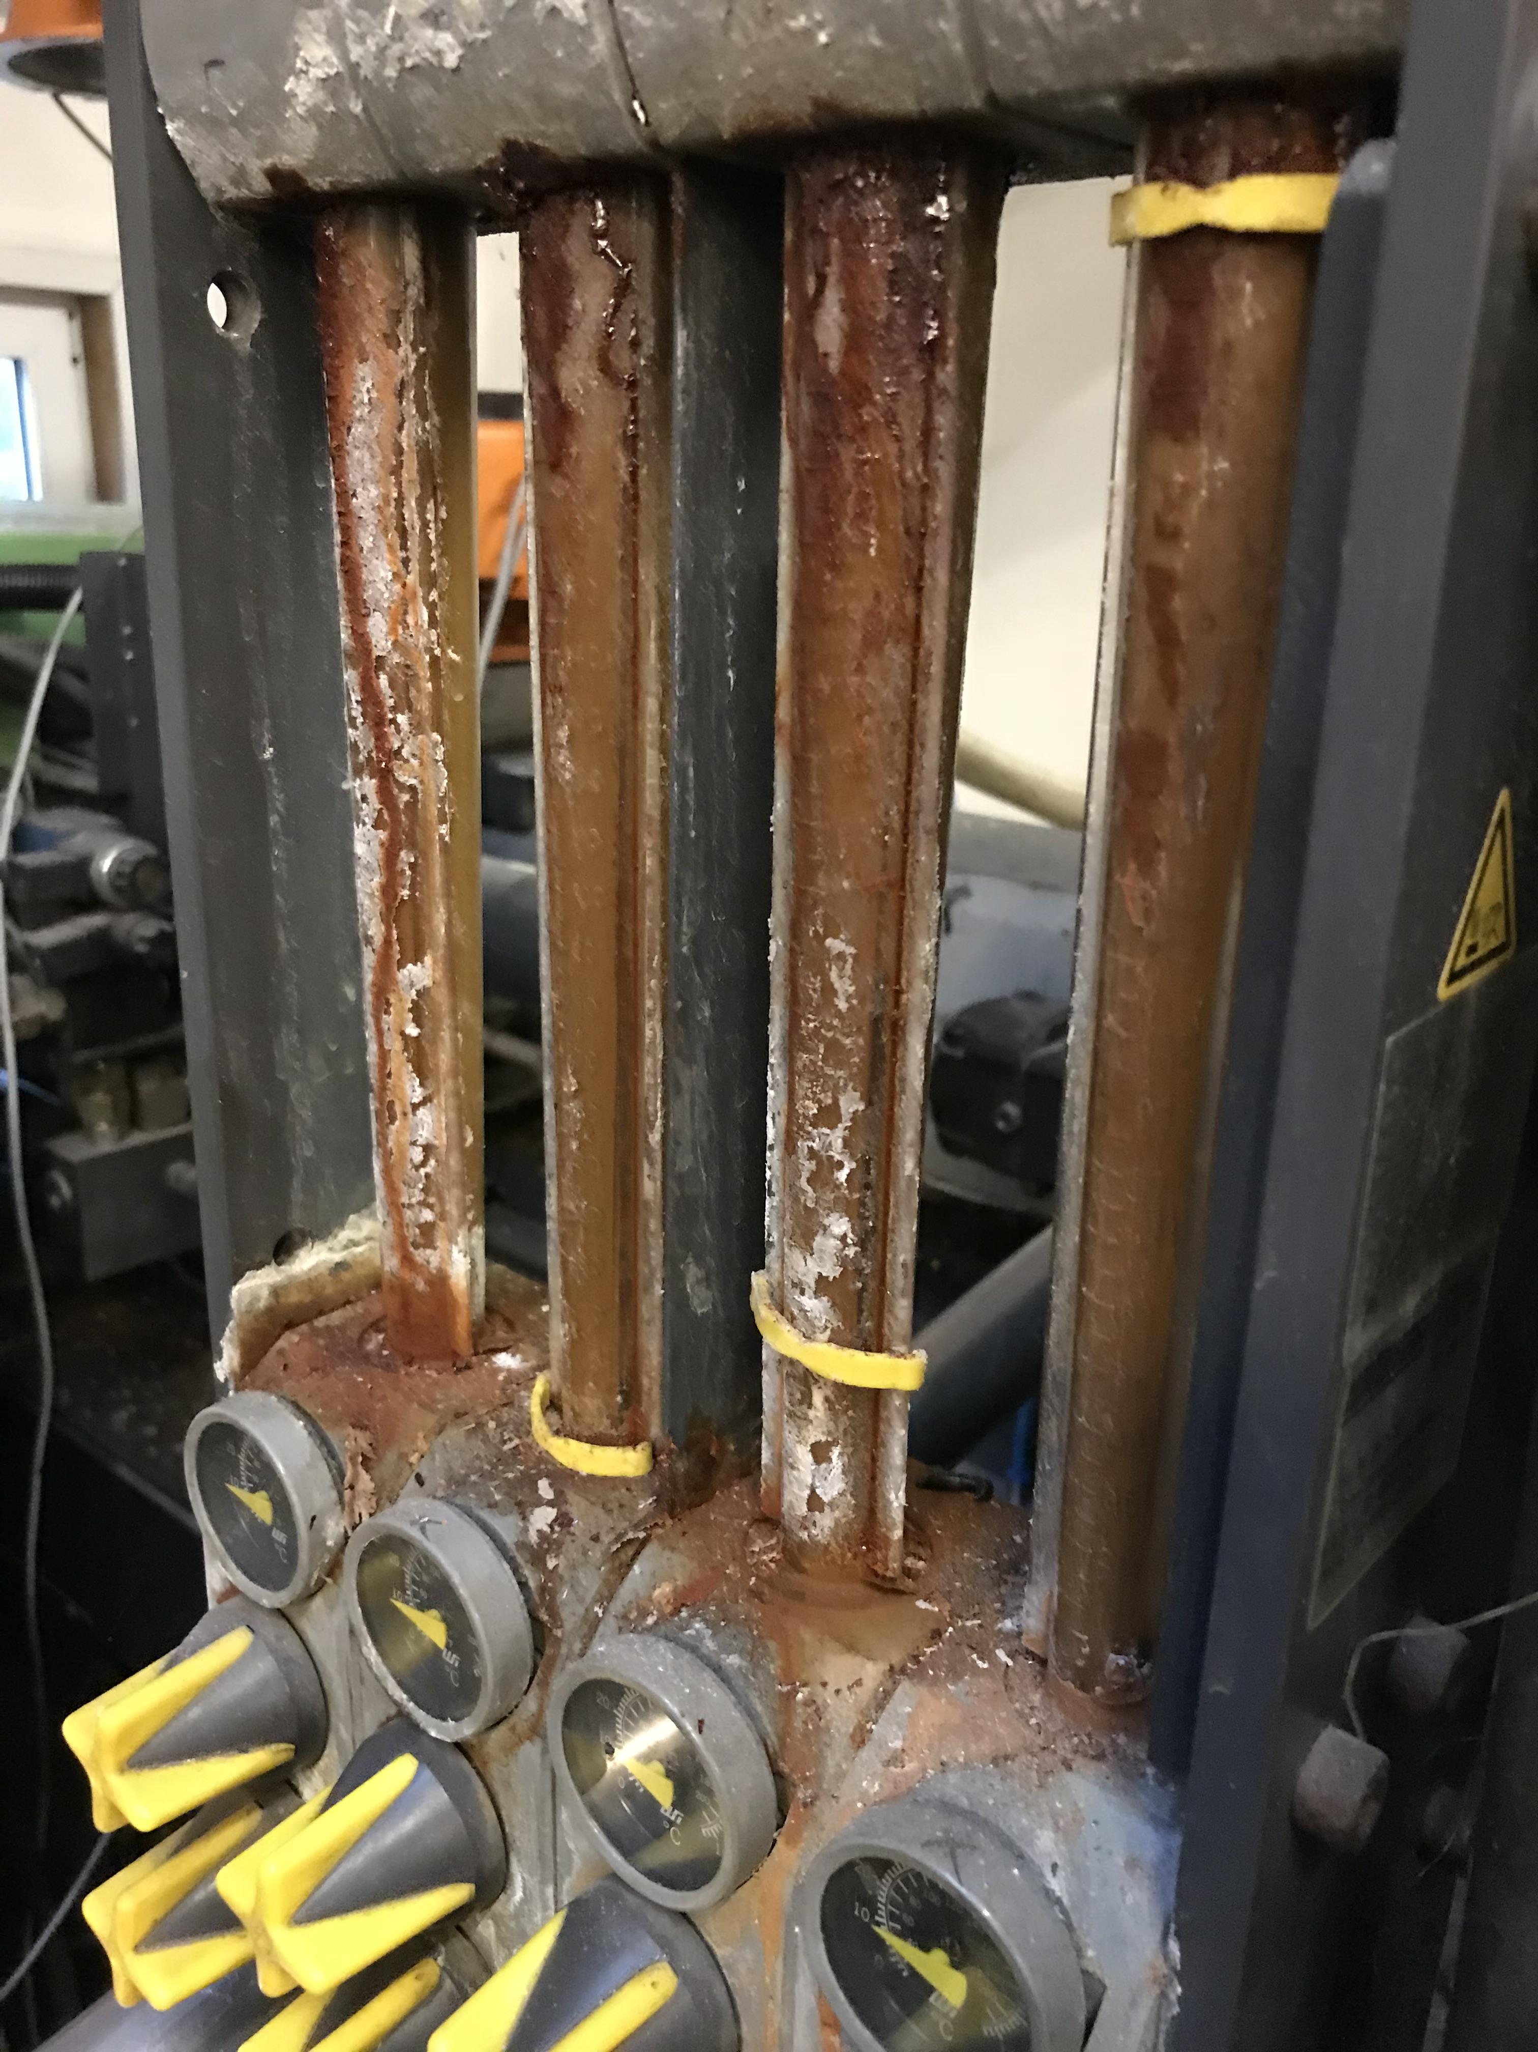
RETRO
Tradicionalni regulatorji pretoka
Propustna konstrukcija
Razbita stekla
Upazano pretočno steklo
Brez opozoril
Omejeno območje temparature
Omejena količina pretoka
DIGITALNI REGULATOR FPRETOKA

Slide 36
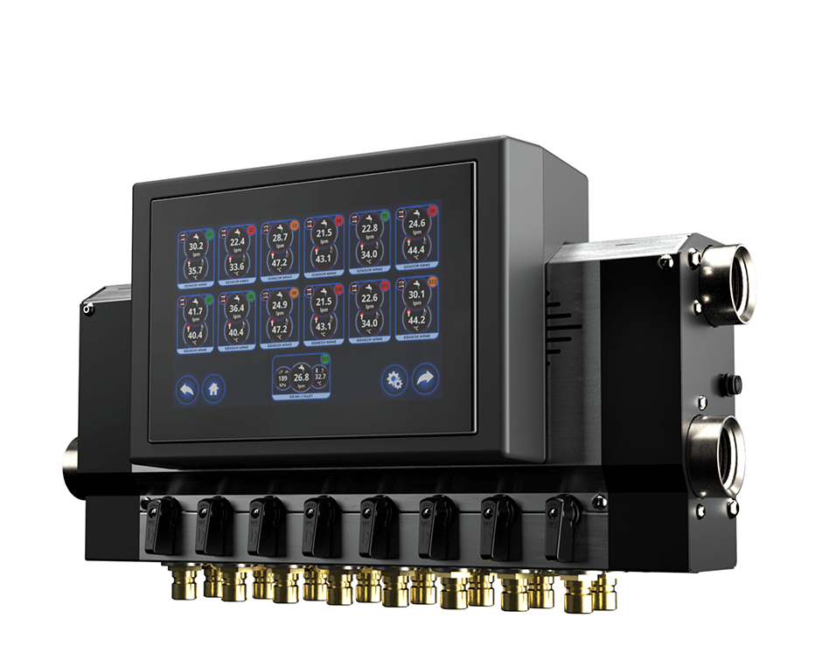
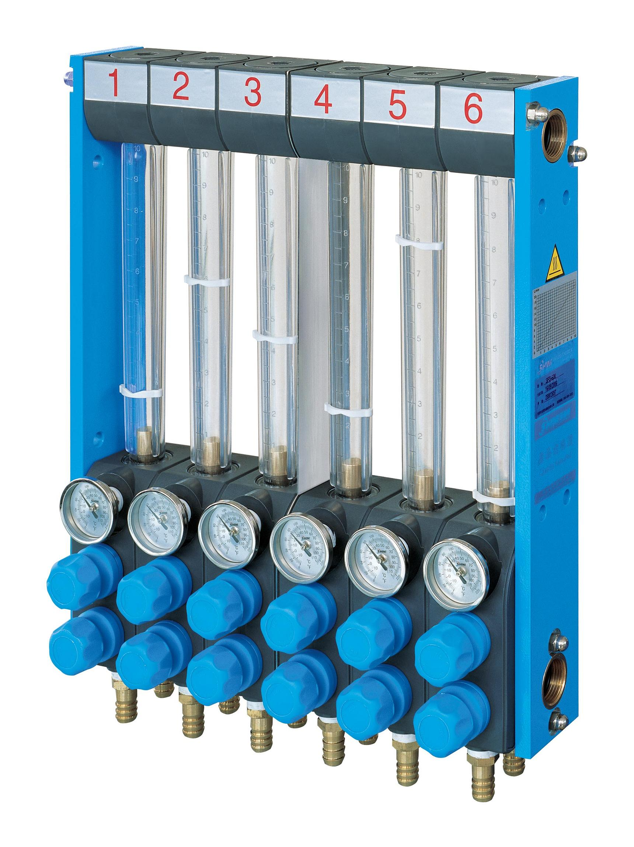
NADGRADNJA
Nadgradite svoj stroj za brizganje z novim digitalnim
regulator pretoka in izboljšajte svojo produktivnost.
÷
✓
Zamenjava tradicionalnih analognih ročnih regulatorjev pretoka z novim digitalnim regulatorjem pretoka vam bo prinesla številne prednosti, kot so:
Digitalni nadzor pretoka, temperature in tlaka
Alarm - opozarjanje
Večja zmogljivost pretoka
Višje temperaturno območje
Shranjevanje in izvoz podatkov
Hitrejše spremembe proizvodnje
OPC-UA / Euromap vmesnik
DIGITALNI REGULATOR FPRETOKA

Slide 37
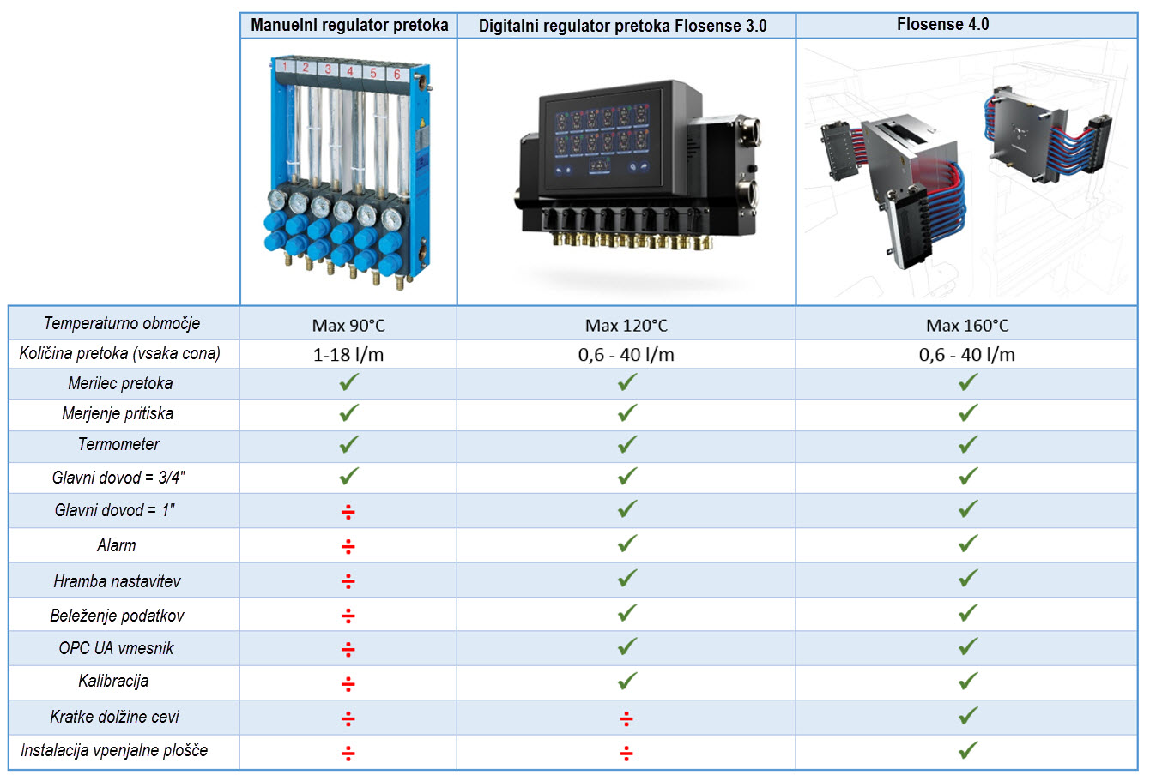
DIGITALNI REGULATOR FPRETOKA

Slide 38
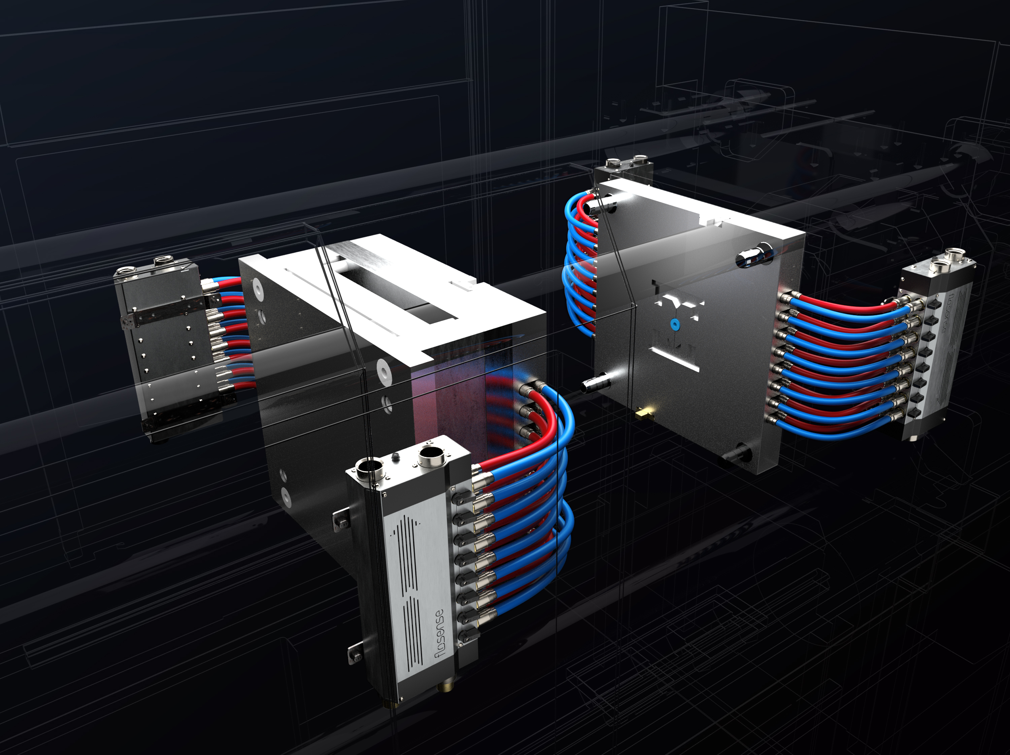
Na zaslon na dotik priključite do 4 razdelilce, da lahko nadzirate do 48 ločenih hladilnih krogov.
Notes:
Flosense 4.0 is the best solution to manage and monitor the coolant or mould temperature control.
The standard configuration supports up to 4 manifolds with each 12 zones or 48 zones in total.
The manifolds are designed to be mounted on the side of the clamping plates. The low compact design makes them fit on even the smallest machine on the market.
The stainless steel design with black edges gives a stylish look and out lines that this is a premium product.

Slide 39
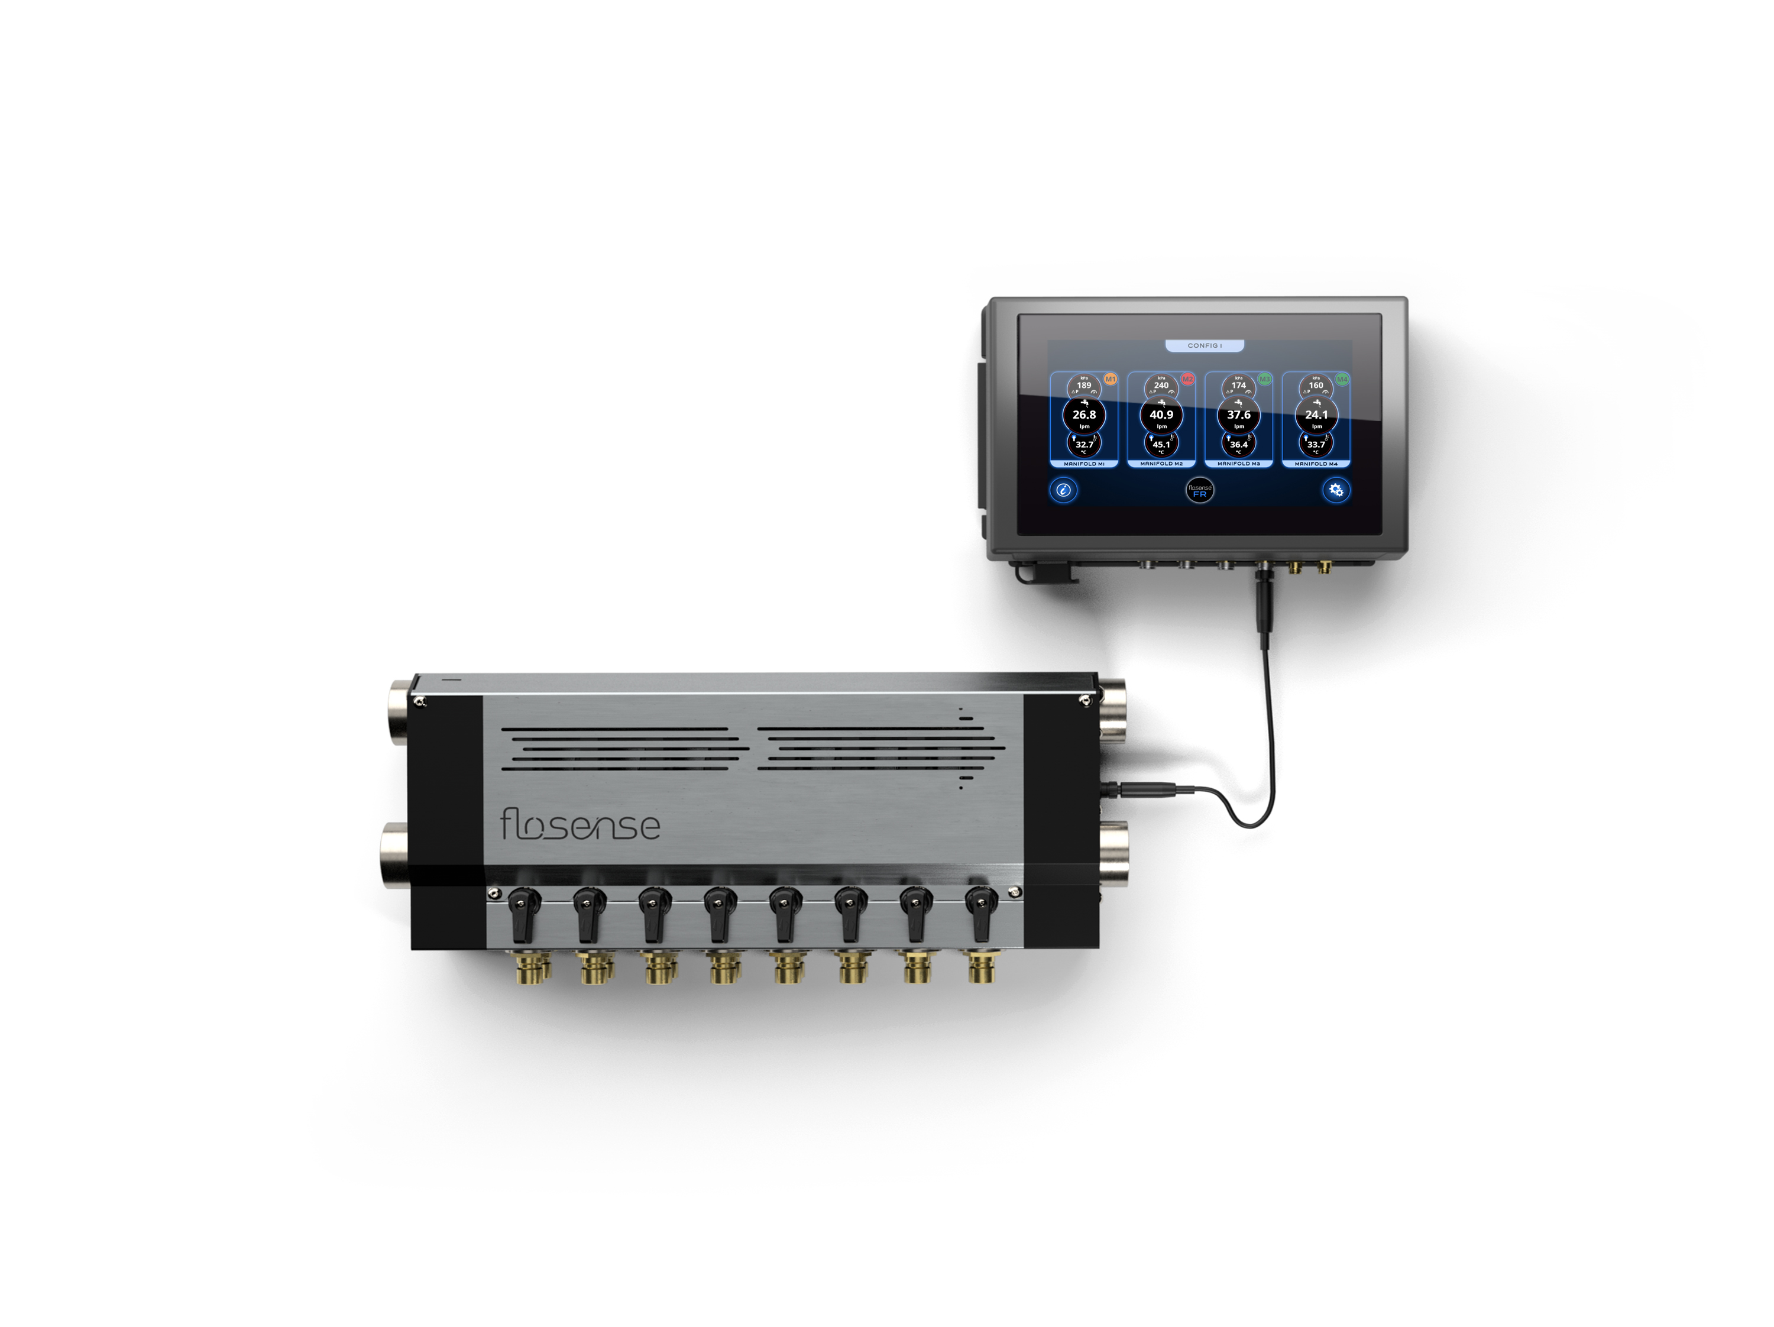
Oddaljena namestitev zaslona / 4 razdelilci
Kompletna enota
s senzorjem pritiska instaliranim na
glavnem vhodu / izhodu.
Notes:
Flosense manifolds are connected to the screen with a single cable – there is no electronic between the manifold and the screen which makes the installation very easy. The manifold is equipped with a connector on both sides of the manifold, so installation is universal. The feed and return can also be connected from both sides.

Slide 40
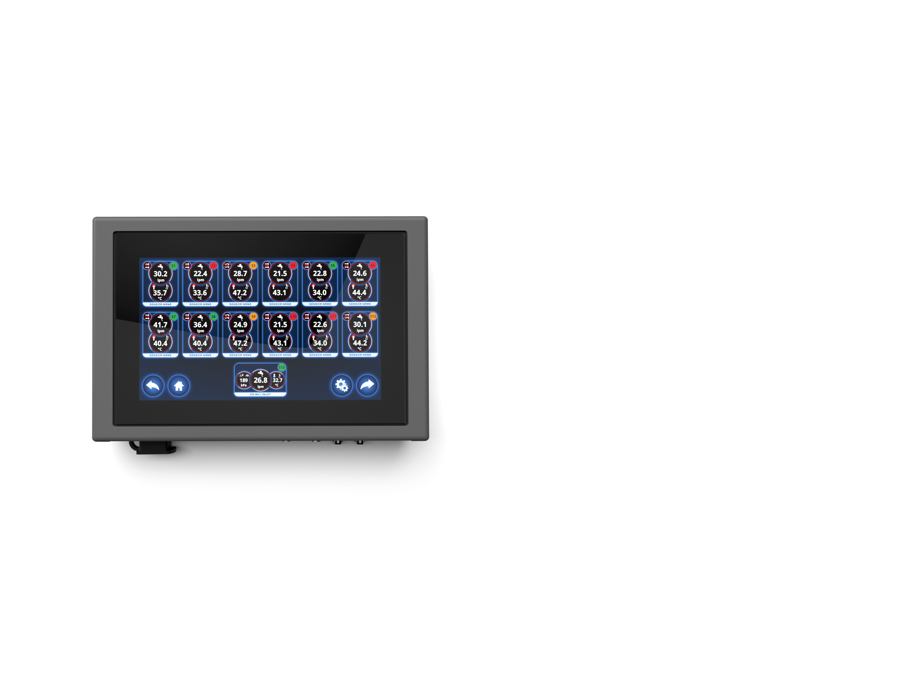
Zaslon na dotik s
4 vhodi razdelilnikov
Z magnetnim nosilcem za enostavno namestitev.
Opremljen s priključki za napajanje, alarm, USB in Ethernet.
Notes:
The screen is 7,1 ” touch screen with simple and intuitive user interface in more than 10 languages.

Slide 41
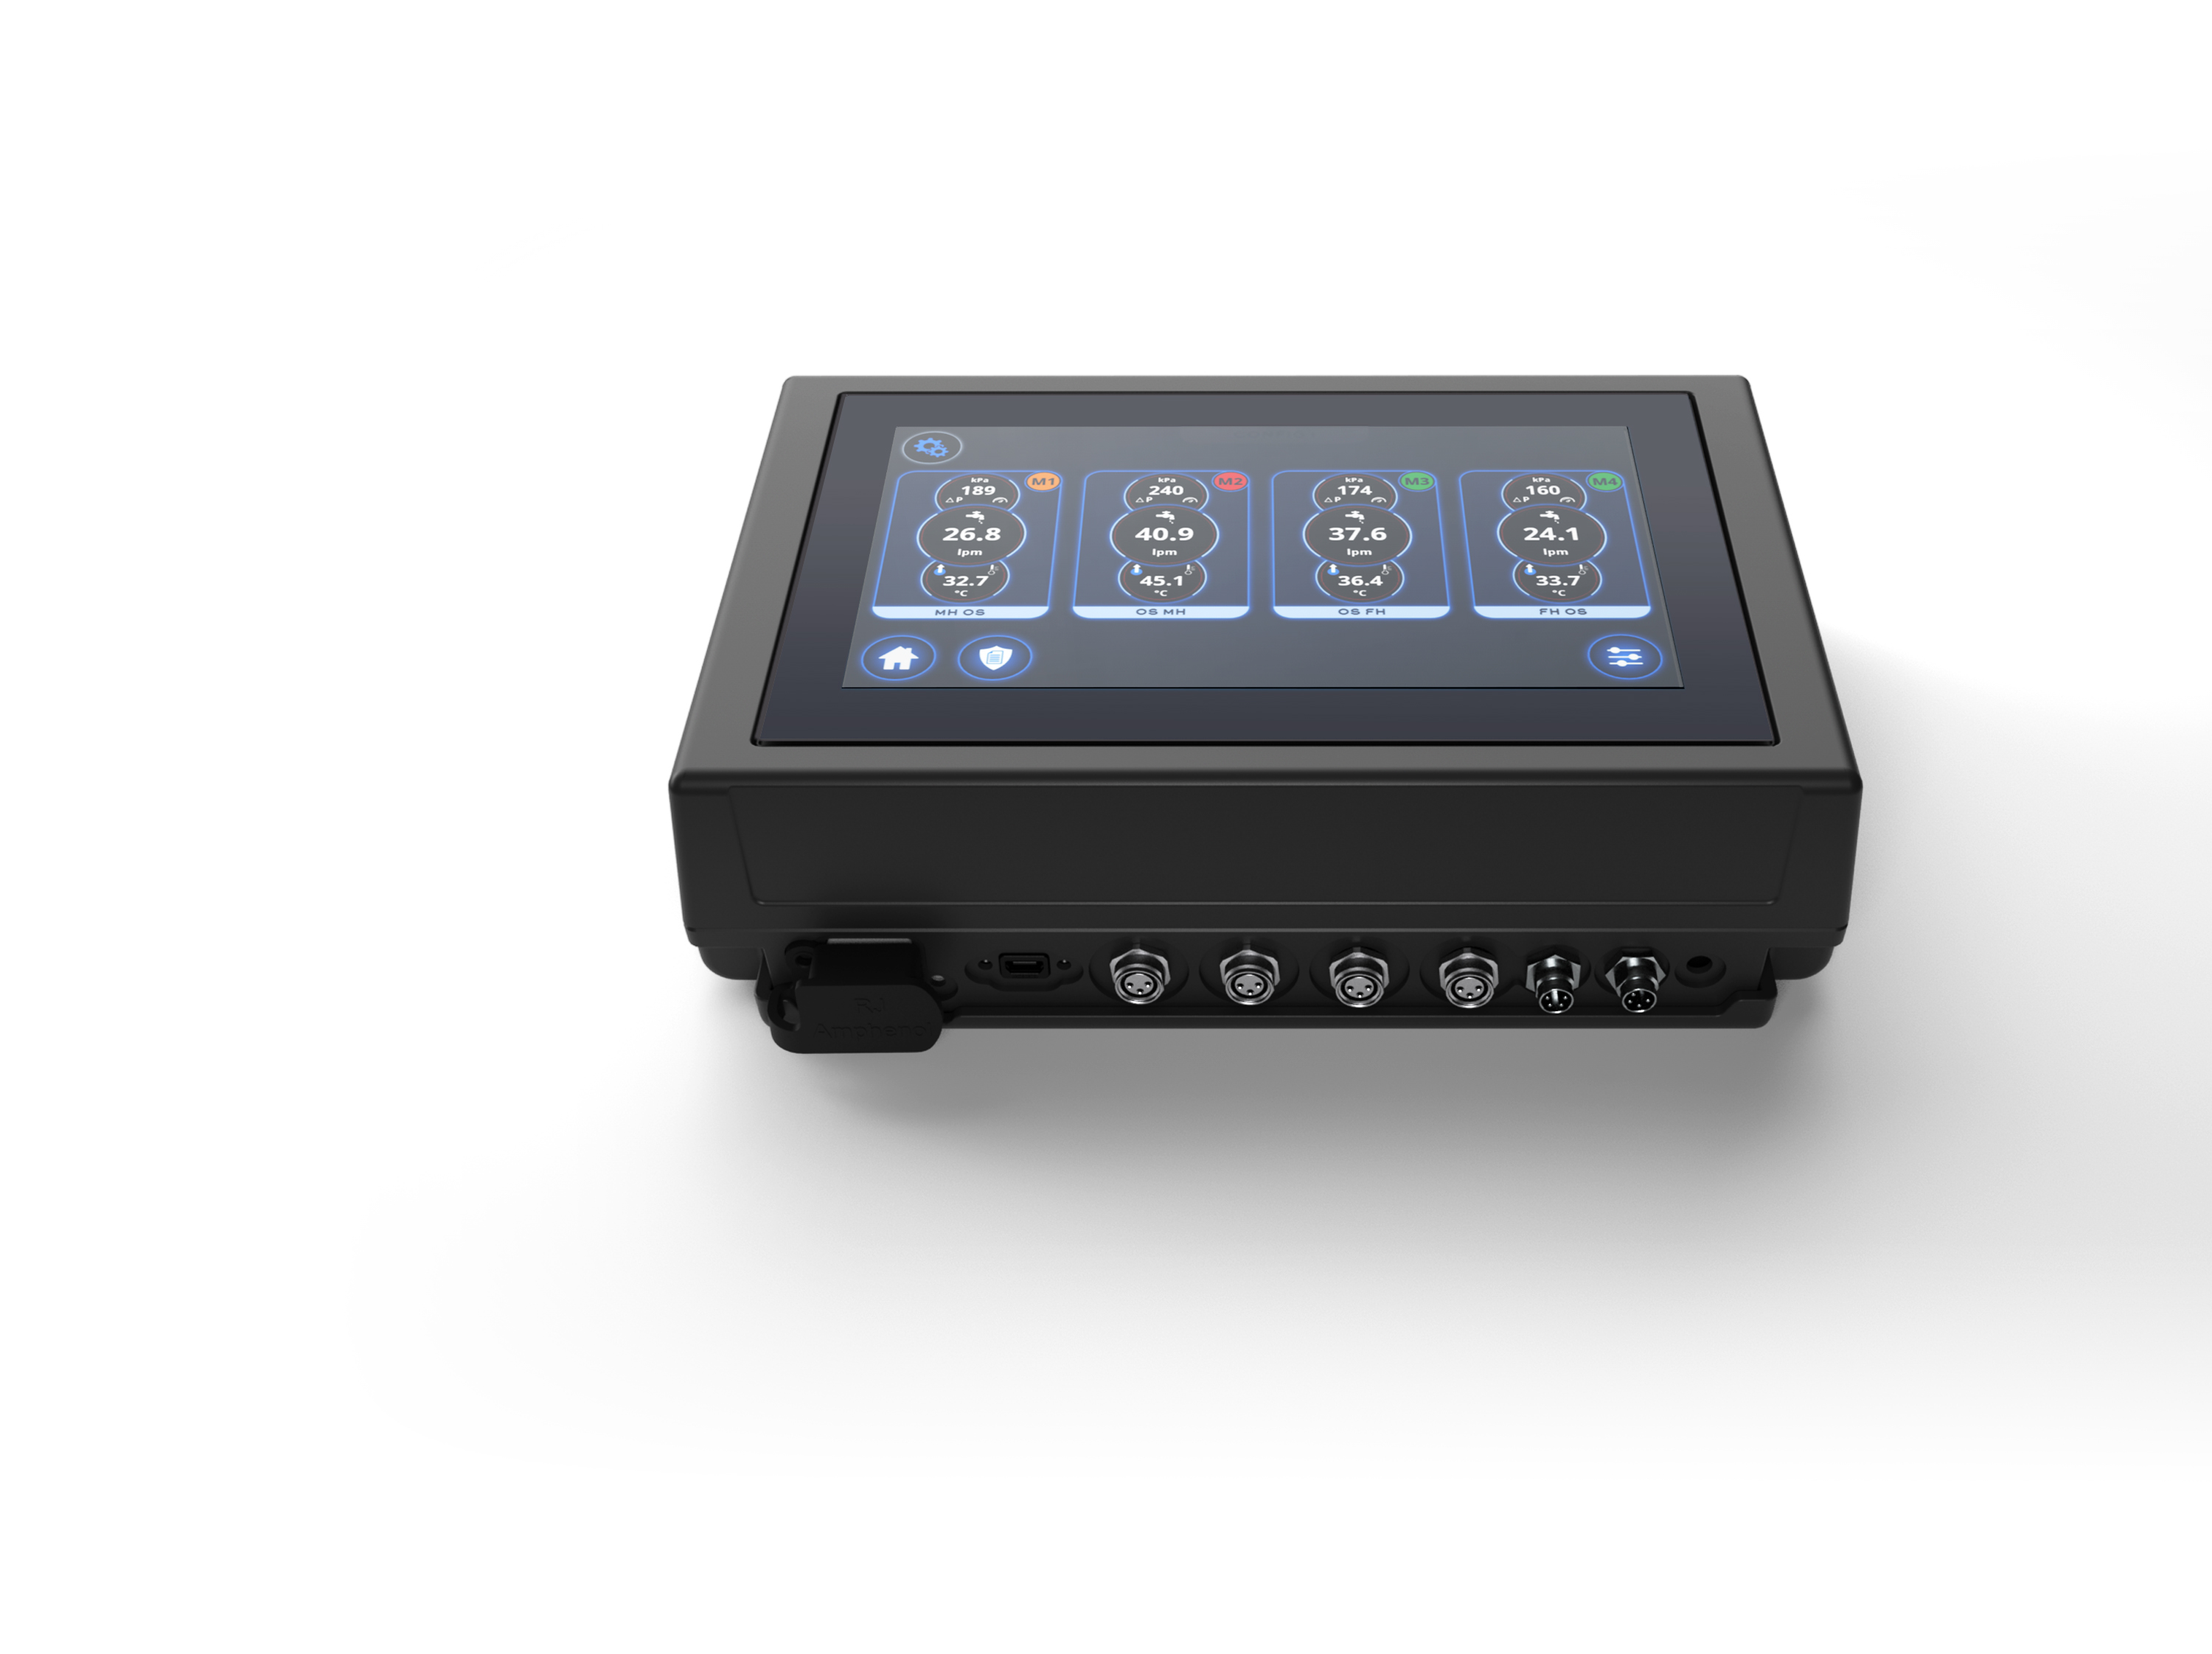
Električni priključki
1. Ethernet povezava
2. USB (mini)
3. Razdelilec 1
4. Razdelilec 2
5. Razdelilec 3
6. Razdelilec 4
7. Izhod za alarm
8. Napetost
1.
2.
3.
4.
5.
6.
7.
8.
Notes:
Port 1: Ethernet which is used for OPC UA (used to communicate with central process monitoring systems or machine integration)
Port 2: USB mini used for software updates or data extraction
Port 3-6: is for manifold connections 1-4 manifolds
Port 7: is alarm output, voltage output to alarm machine, beacon etc.
Port 8: is the power input.

Slide 42
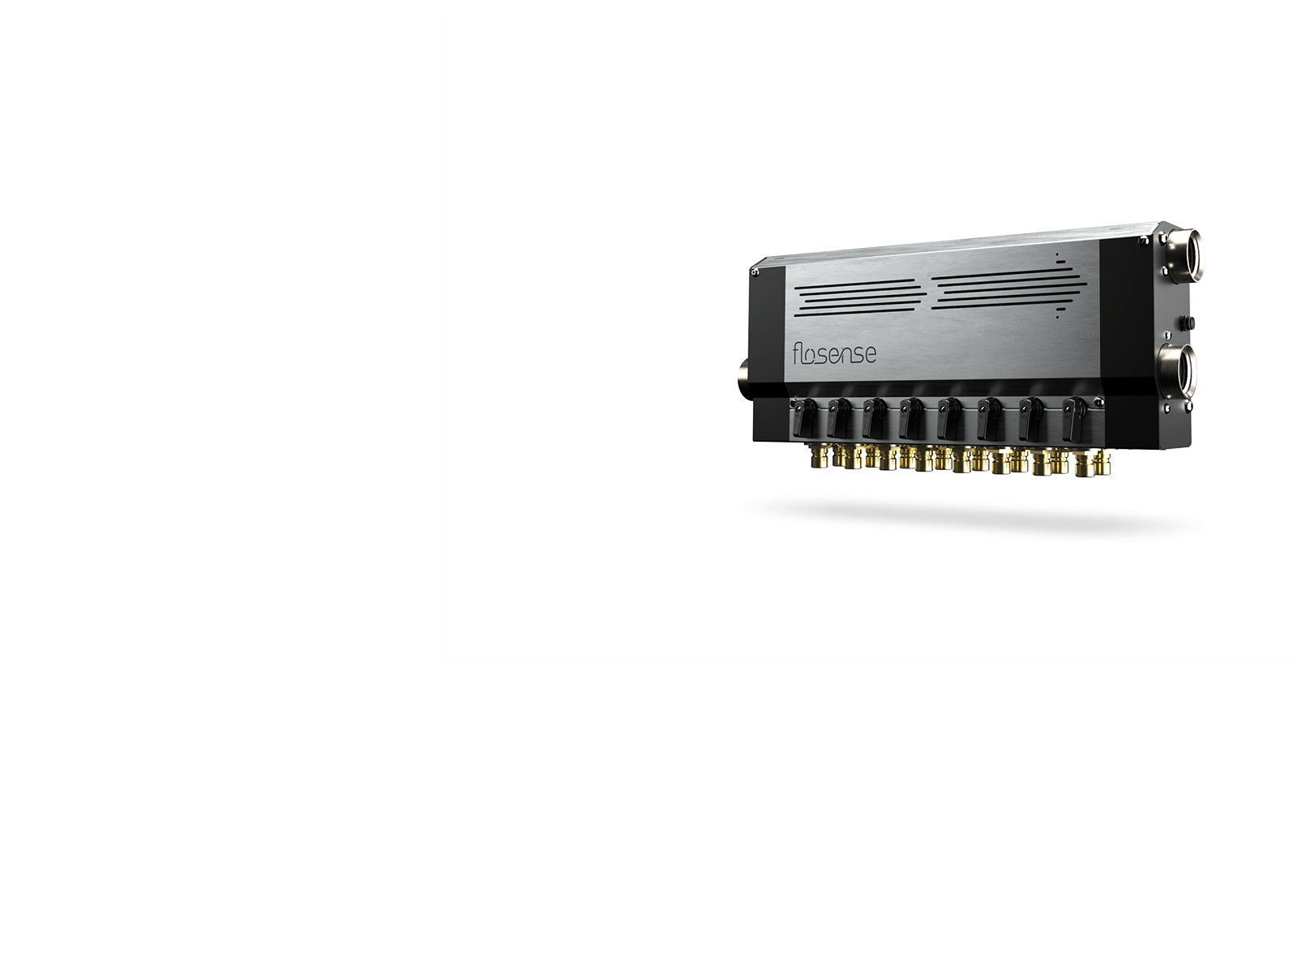
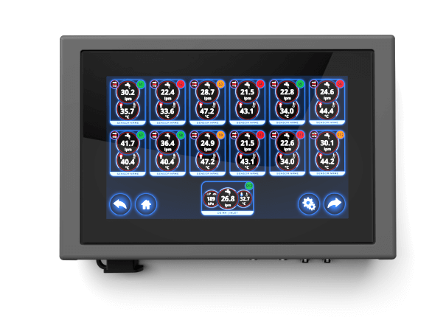
Prednosti za stranke
Hitrejše prestavljanje forme
  Shranjene nastavitve/parametri bodo naslednjič dovolili dosti hitrejšnje nastavljanje forme
Zmanjšan čas cikla
  Detajlne informacije o vsakem kanalu delta T bodo dovolile pametnejša porazdelitev hlajenja in optimiziran prenos toplote
Izboljšana kakovost izdelka
  Optimiziran prenos toplote bo zagotovil konsistentno kakovost izdelkov
Reducirani ostanki
  Okvarjeni deli zaradi blokiranih vodnih poti bodo odpravljeni pri spremljanju pretoka, temperature in tlaka.
Varčevanje z energijo
  Hlajenje ali izguba visokega pritiska zahteva več energije črpalke. Flosense bo pomagal prilagoditi to dejanskim potrebam in pomagal k zmanjšanju izgube tlaka.
Večja produktivnost
  Nabiranje rje in onesnaževanje vode bo povzročilo nenačrtovane okvare in zastoje v proizvodnji. Flosense bo zagotovil podatke za načrtovanje potrebnega vzdrževanja in izgube tlaka.
DIGITALNI REGULATOR PRETOKA

Slide 43
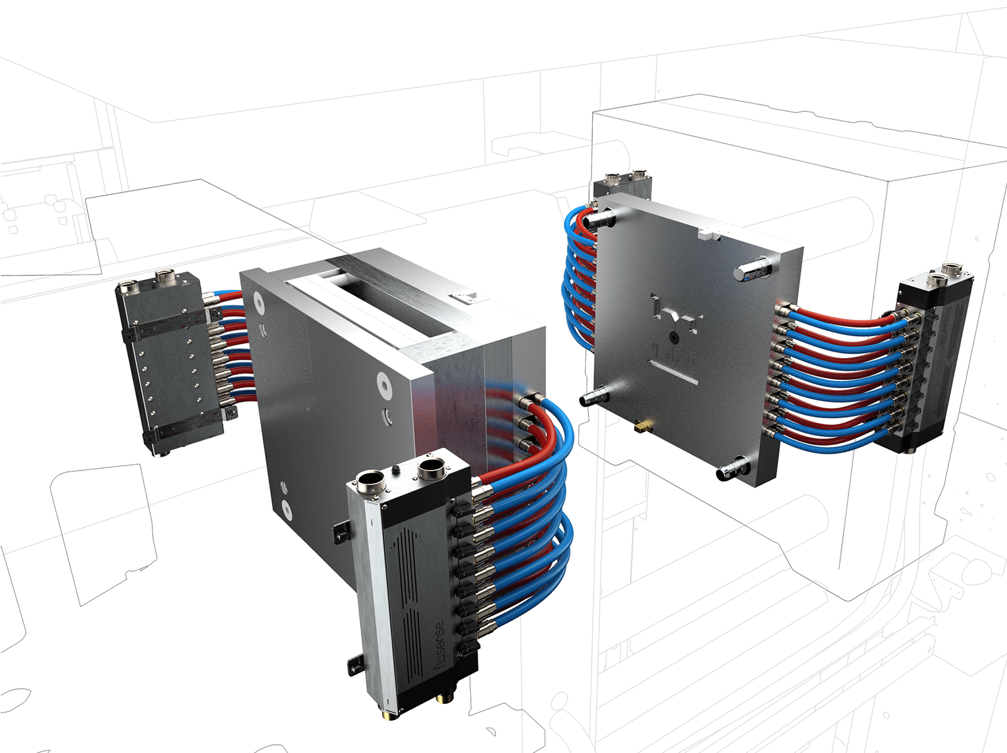
Konfiguracija sistema
Na zaslon na dotik priključite do 4 razdelilnike, da lahko nadzirate do 48 ločenih hladilnih krogov.
DIGITALNI REGULATOR PRETOKA
Notes:
This is how the system is normally configured. Let’s look into how it looks on the screen with this configuration.

Slide 44
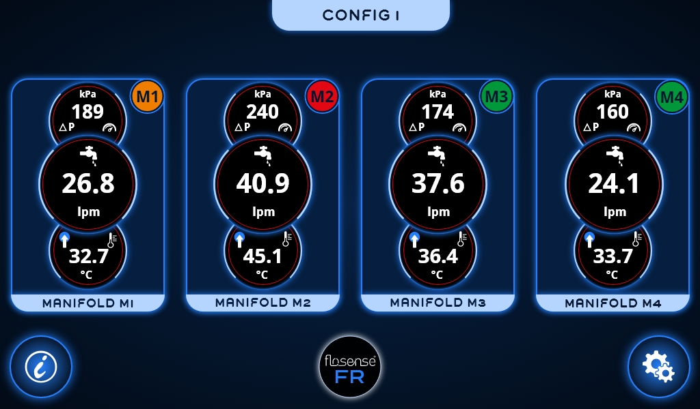
NASTAVITEV
FORME
Na zaslon na dotik priključite do 4 razdelilnike, da lahko nadzirate do 48 ločenih hladilnih krogov.
DIGITALNI REGULATOR PRETOKA
Notes:
The main Screen will show the number of manifolds connected.

Slide 45
ZASLON NA DOTIK
Pregledni zaslon, ki prikazuje vsak razdelilnik. Prikaz skupnega pretoka v razdelilniku, dohodne temperature, Delta P
DIGITALNI REGULATOR PRETOKA
Notes:
Each manifold will show overall details: the total flow through the manifold, the feed temperature and the feed pressure.
If you would like to see a specific manifold, you simply clik on the selected manifold.

Slide 46
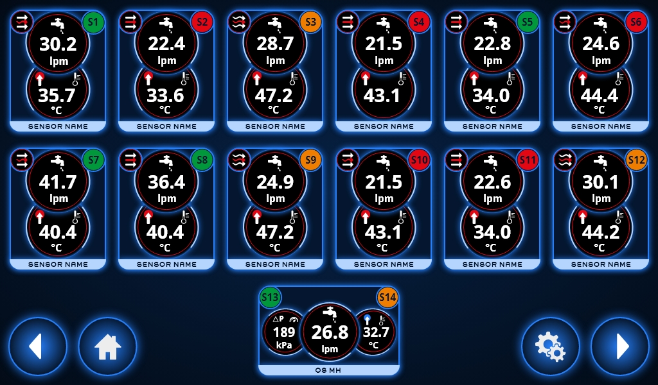
TOKOKROGI
Na zaslon na dotik priključite do 4 razdelilnike, da lahko nadzirate do 48 ločenih hladilnih tokokrogov.
DIGITALNI REGULATOR PRETOKA
Notes:
The manifold you selected refering to the ID you defined. In this case we select Manifold No. 1

Slide 47
The main screen will show all circuits with information about flow and temperature.The main inlet and outlet will also show
including pressure.
ZASLON NA DOTIK
Zaslon za podrobnosti razdelilnika - do 12 vezij
DIGITALNI REGULATOR PRETOKA
Notes:
We now see each channel on the selected manifold. Upper secttion channel 1 throug 12 with details. In the lower, section the total sum calculated.
If you would like to see a specific channel, you simply click on the selected channel.

Slide 48
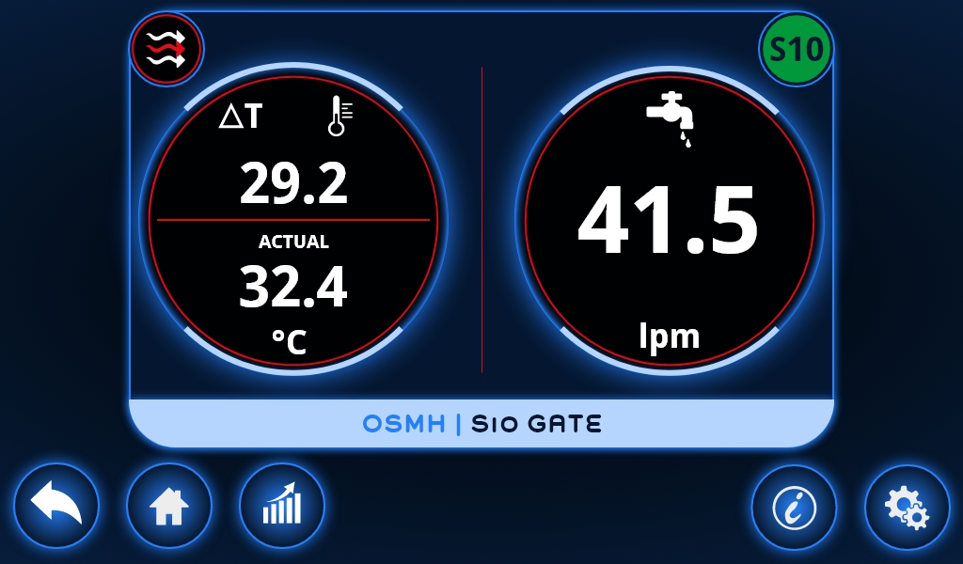
Specifični
tokokrog
Connect up to 4 manifolds to the touch screen in order to monitor up to 48 separate cooling circuits.
DIGITALNI REGULATOR PRETOKA
Notes:
In this case, we look into channel 10.

Slide 49
Posamezni zaslon pretoka tokokroga, temperature in Delta T (ime vezja, stanje alarma, turbulenten indikator pretoka)

Slide 50
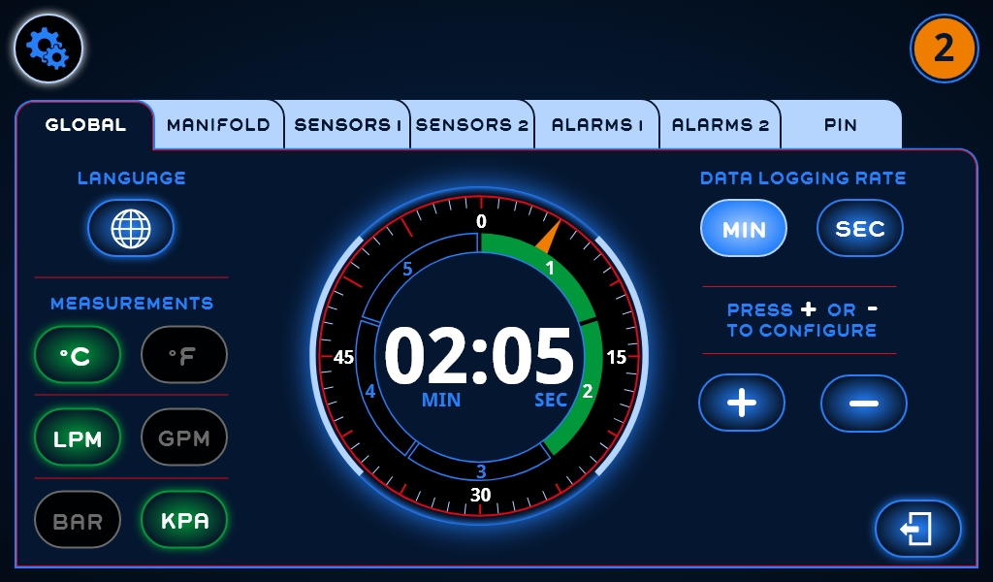
Zaslon z nastavitvami - s tega zavihka nastavite jezik, enote in hitrost prenosa podatkov

Slide 51
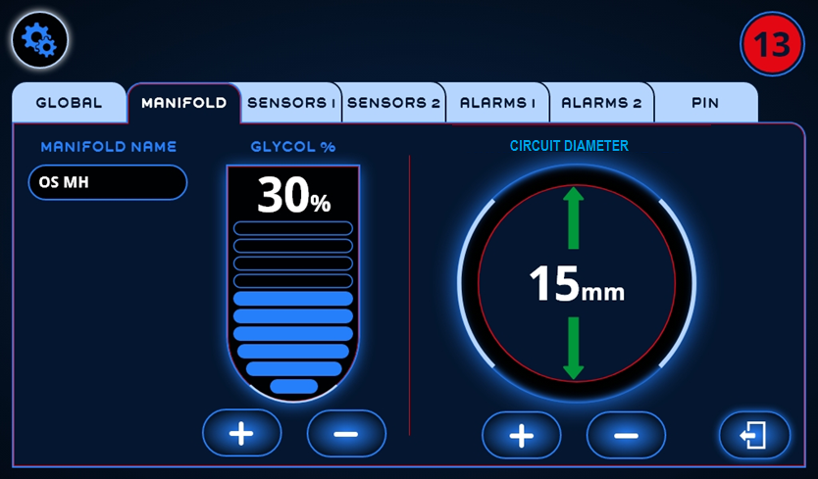
Zaslon z nastavitvami - na tem zavihku nastavite ime razdelilnika, odstotek glikola (viskoznost), premer kanala

Slide 52

Zaslon z nastavitvami - na tem zavihku nastavite zgornjo in spodnjo mejo alarma za vsako vezje glede pretoka in temperature

Slide 53

Grafični zaslon - grafika posameznega tokovnega tokokroga

Slide 54
Kritične mere razdelilca
PRETOK
Standardni senzor
HT senzor
Merilno območje
1-20 l/min (0,27-5,2 gpm)
1-20 l/min (0,27-5,2 gpm)
2-40 l/min (0,53-10,4 gpm)
2-40 l/min (0,53-10,4 gpm)
Natančnost
(± 1 σ) v vodi, ± 1 % FS
(± 1 σ) v vodi, ± 1 % FS
TEMPERATURA
Merilno območje
0-120 °C (32-248 °F)
0-160°C (32-320°F)
Natančnost
15-90 °C (59-194 °F) ± 0.5 K
15-90 °C (59-194 °F) ± 0.5 K
0-120 °C (32-248 °F) ± 1 K
0-120 °C (32-248 °F) ± 1 K
(± 1 σ) v vodi, ± 1 % FS
120-160 °C (248-320 °F) ± 2 K
PRITISK
Merilno območje
0-10 bar (0-145 psig)
Natančnost
± 2.5 % FS

Slide 55
Dimenzije
Material:
Pretočni moduli:
medenina / ponikljana /
Onišje:
nerjavno jeklo
PART NO.
Porti
L / mm /
W / mm /
H / mm /
F4M4
4
220
155
72
F4M6
6
287
155
72
F4M8
8
354
155
72
F4M10
10
421
155
72
F4M12
12
488
155
72
L
W
H

Slide 56



Konkurenca
Kdo je naša konkurenca?
Številni konkurenti ponujajo merilnike pretoka, le nekaj pa jih ponuja sisteme nadzora pretoka za nadzor temperature forme.
Najmočnejša tekmovalca sta: Engel in Mouldflo.
Engel se osredotoča samo na Engel Machines, zato je naš glavni neposredni konkurent Mouldflo.
Oglejmo si glavne teme, kot so cena, zmogljivost in funkcije.
… NADZOR PRETOKA

Slide 57

Konkurenca
… NADZOR PRETOKA
Notes:
All our competitors have complicated and expensive connection electronics. This images is from ONI, a German company specialized in turn key solutions for cooling and temperature control. They have 100 engineers employed, but look at this bulky set-up. The electronic interface is bigger than the screen and cables and connection takes a crazy amount of space.

Slide 58

Velikost
Pravilno in v aplikacijah za brizganje je prostor omejen,
zato bolj kompaktno je bolje…..
… NADZOR PRETOKA
Notes:
Size is critical. Moulding machines are made as small as possible, in order for as many as possbile to fit in production facilities. There is very limited space inside the moulding machine, but Flosense is the most compact available on the market.

Slide 59

Mouldflo Alu
Mouldflo SS
Flosense
33 % manjši
Notes:
Let’s compare with the second best ”Mouldlflo”: Flosense is smaller on all 3 dimensions.

Slide 60


Mouldflo Alu
Mouldflo SS
Flosense
33 % manjši
Notes:
Furthermore, the length is significant shorter.
Note! Flosense has built in pressure sensors, so if you add pressure sensors on a Mouldflo, the length will be even longer and cables sticking out.

Slide 61
Unikatne lastnosti
Flosense je unikaten z unikatnimi lastnostmi:
2 v1 in 3 v1 senzorsko tehnologijo
Območja pretoka 0,6 – 200 l/m (0.16 – 53 gpm)
Temperature 0-160°C (320°F)
Kompaktna in univerzalna oblika
Korozijsko obstojni materiali
Plug & Play ready

Slide 62
Cene
Cene Flosense so za 30-50% nižje od konkurenčnih
Notes:
The reason for this aggresive price strategy is to make Flosense affordable to anyone. Everyone can benefit from using Flosense, not only rich medical companies. Our strategy is to make marging from selling volumes.

Slide 63

PRETOČNE CEVI
Za naknadno vgradnjo obstoječih razdelilcev
… NADZOR PRETOKA
Notes:
Flosense 2.0 is an optional feature for customers who already have manifolds installed on their moulding machine. We can retrofit the manifolds with the FSE flow pipes and equip them with daisy chain cables. This will register on the screens as a traditional Flosense manifold and give the samme features.
This solution requires custom cables, so not off the shelves product. The system can be equipped with the same sensor type, also pressure sensors.

Slide 64

PRIDE KMALU …
Črna škatla za neposredno integracijo v krmilje stroja
ali s tehnologijo VNC
(virtuel network computing).
… NADZOR PRETOKA
Notes:
We are already working on next step: Flosense 5.0 which is the same user interface, just based on a Black Box server instead of touch screen. This will allow VNC integration to machine controls or remote access to the data via Ethernet.
This unit will also be designed to connect more than 4 manifolds – we hope to connect up to 8 or 9 manifolds to the unit.

Slide 65

Vprašanja?
… NADZOR PRETOKA

Slide 66
zastopanje za Slovenijo
HALDER d.o.o.
Miklavška cesta 50
SI-2311 Hoče, Slovenija
info@halder.si
T: +386 2 61 82 646
www.halder.si

